Slide 1
Nivolumab plus ipilimumab with chemotherapy as first-line treatment for patients with metastatic non-small-cell lung cancer: final, 6-year outcomes from CheckMate 9LA
Carbone D P et al. ESMO Open 2025. 10(6). https://doi.org/10.1016/j.esmoop.2025.105123
7356-NL-2500032

Slide 2
CheckMate 9LA: Final 6-Year Safety and Efficacy Outcomes
A randomized, open-label phase III trial evaluated outcomes in patients with metastatic NSCLC treated with single or dual immune checkpoint inhibitors in combination with chemotherapy.
Key eligibility criteria:
Stage IV or recurrent NSCLC
No prior systemic therapy
ECOG PS 0-1
No sensitizing EGFR mutations or
known ALK translocations
NIVO 360mg Q3W + IPI 1mg/kg Q6W + Chemo^{c} Q3W (2 cycles)
(n=361)
Primary endpoints
OS
Secondary endpoints
PFS by BICR^{d}
ORR by BICR^{d}
Efficacy by tumor
PD-L1 expression
Until disease progression, unacceptable toxicity, or for 2 years for immunotherapy
R
1:1
(n=719)
Stratification factors:
Tumour PD-L1ª expression (<1% vs. ≥1%)
Tumor histology (SQ vs NSQ)
Sex
Chemo^{c} Q3W (4 cycles)
(n=358)
With optional pemetrexed maintenance (NSQ)
ªDetermined by the PD-L1 IHC 28-8 pharmDx assay (Dako).
^{b}Patients with tumors not evaluable for PD-L1 were stratified to PD-L1 <1% and capped to 10% of all randomized patients.
^{c}NSQ: pemetrexed + carboplatine or cisplatin, with optional post-chemo pemetrexed maintenance; SQ: paclitaxel + carboplatin.
^{d}Hierarchically statistically tested.
ALK: anaplastic lymphoma kinase; BICR: blinded independent central review; Chemo: chemotherapy; ECOG PS: Eastern Cooperative Oncology Group Performance Status; EGFR: epidermal growth factor receptor; IPI: ipilimumab; n: number of subjects; NIVO: nivolumab NSCLC: non-small cell lung cancer;
NSQ: non-squamous; ORR: objective response rate; OS: overall survival; PD-L1: programmed death ligand 1; PFS: progression free survival; Q3W: once every 3 weeks; Q6W: once every 6 weeks; R: randomization; SQ: squamous.
Carbone D P et al. ESMO 2025. 10(6). https://doi.org/10.1016/j.esmoop.2025.105123
Carbone D P et al. ESMO 2025. 10(6). https://doi.org/10.1016/j.esmoop.2025.105123. Supplementary appendix.

Slide 3

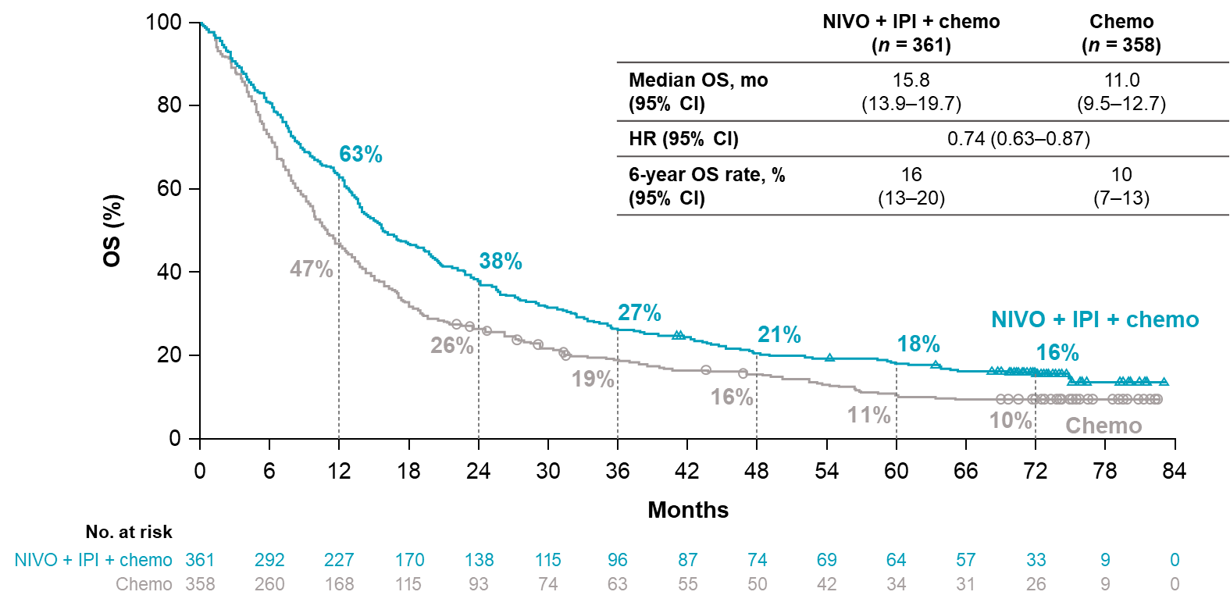
Overall survival
In all randomized patients
Chemo: chemotherapy; CI: confidence interval; HR: hazard ratio; IPI: ipilimumab; mo: months; n: number of subjects; NIVO: nivolumab; OS: overall survival.
Carbone D P et al. ESMO 2025. 10(6). https://doi.org/10.1016/j.esmoop.2025.105123

Slide 4
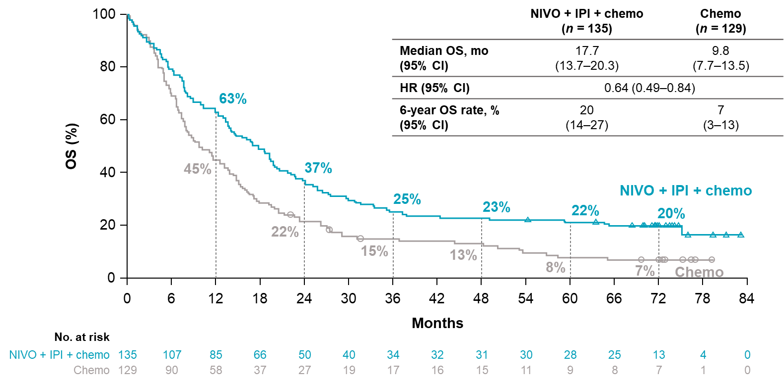
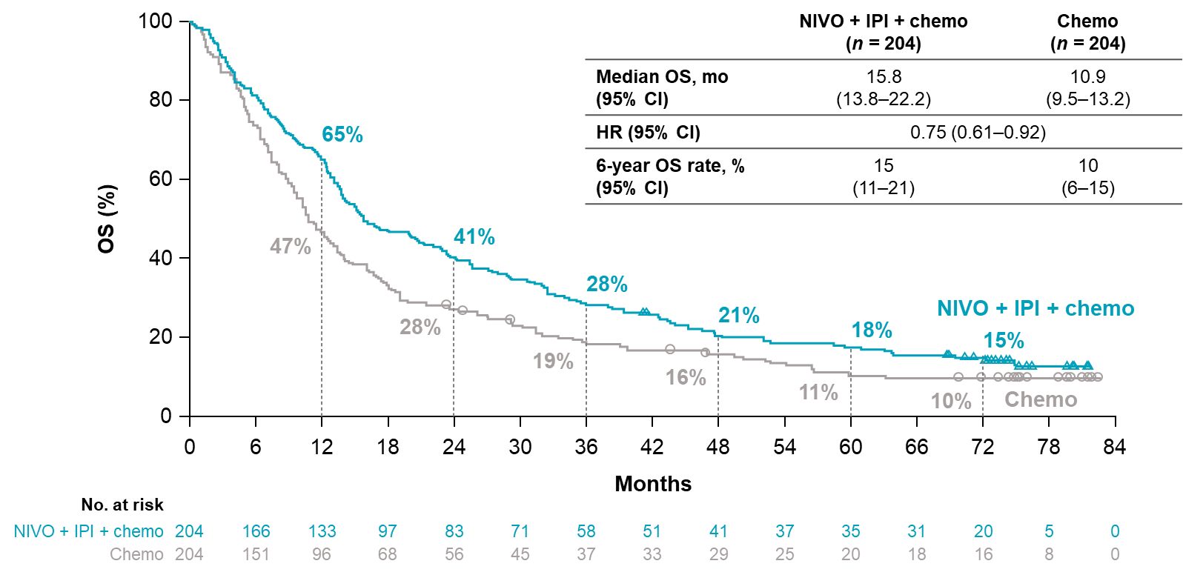
Overall survival
In PD-L1 <1%
In PD-L1 ≥1%
Chemo: chemotherapy; CI: confidence interval; HR: hazard ratio; IPI: ipilimumab; mo: months; n: number of subjects; NIVO: nivolumab; OS: overall survival; PD-L1: programmed death ligand 1.
Carbone D P et al. ESMO 2025. 10(6). https://doi.org/10.1016/j.esmoop.2025.105123

Slide 5
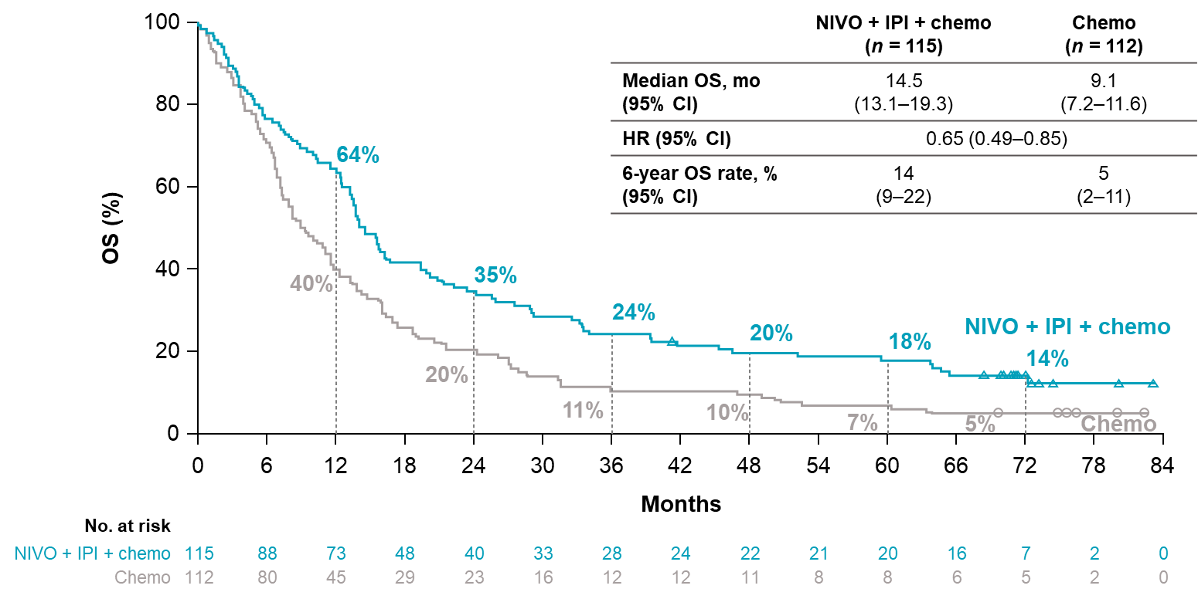
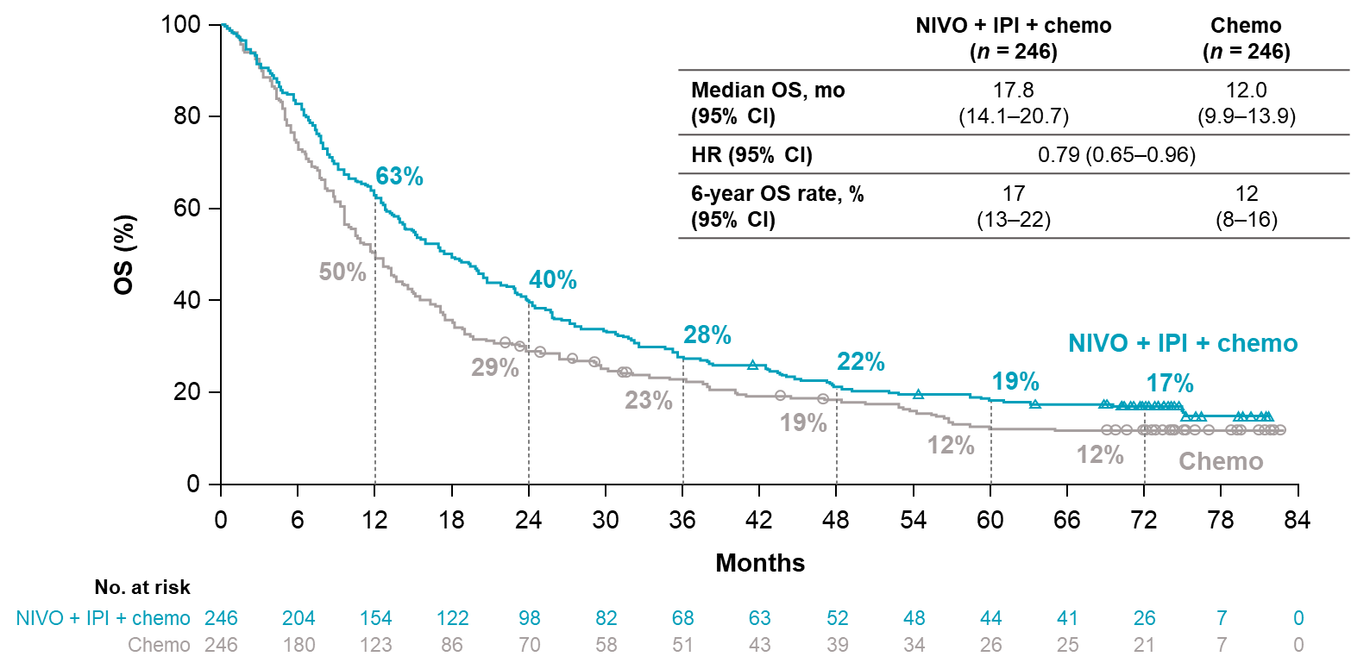
Overall survival
In SQ
In NSQ
Chemo: chemotherapy; CI: confidence interval; HR: hazard ratio; IPI: ipilimumab; mo: months; n: number of subjects; NIVO: nivolumab; NSQ: non-squamous; OS: overall survival; SQ: squamous.
Carbone D P et al. ESMO 2025. 10(6). https://doi.org/10.1016/j.esmoop.2025.105123

Slide 6
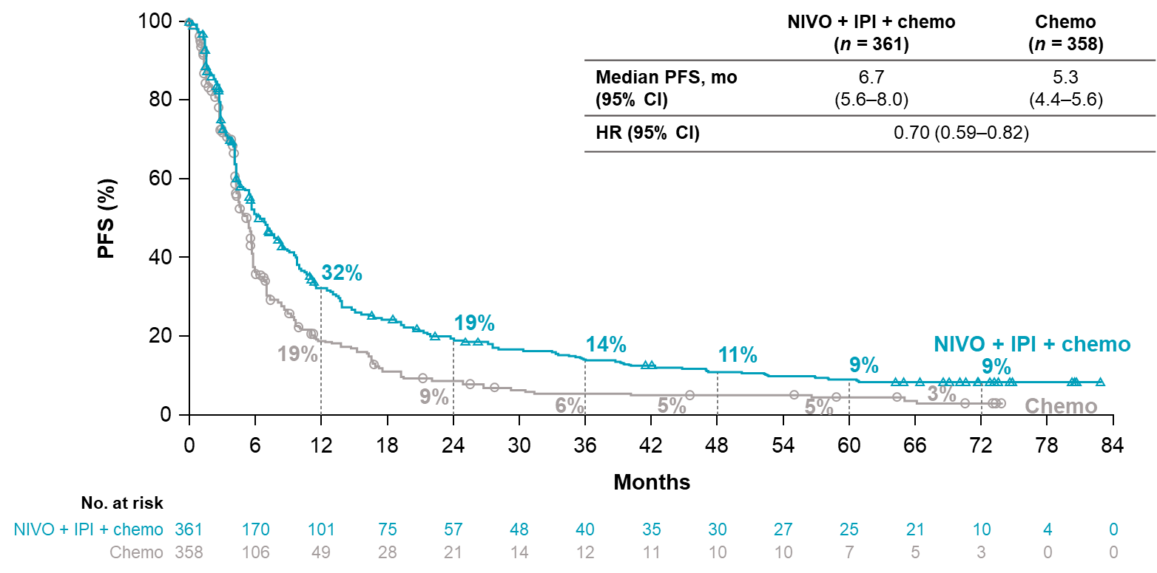
Progression free survival
In all randomized patients
Chemo: chemotherapy; CI: confidence interval; HR: hazard ratio; IPI: ipilimumab; mo: months; n: number of subjects; NIVO: nivolumab; PFS: progression free survival.
Carbone D P et al. ESMO 2025. 10(6). https://doi.org/10.1016/j.esmoop.2025.105123. Supplementary appendix.

Slide 7
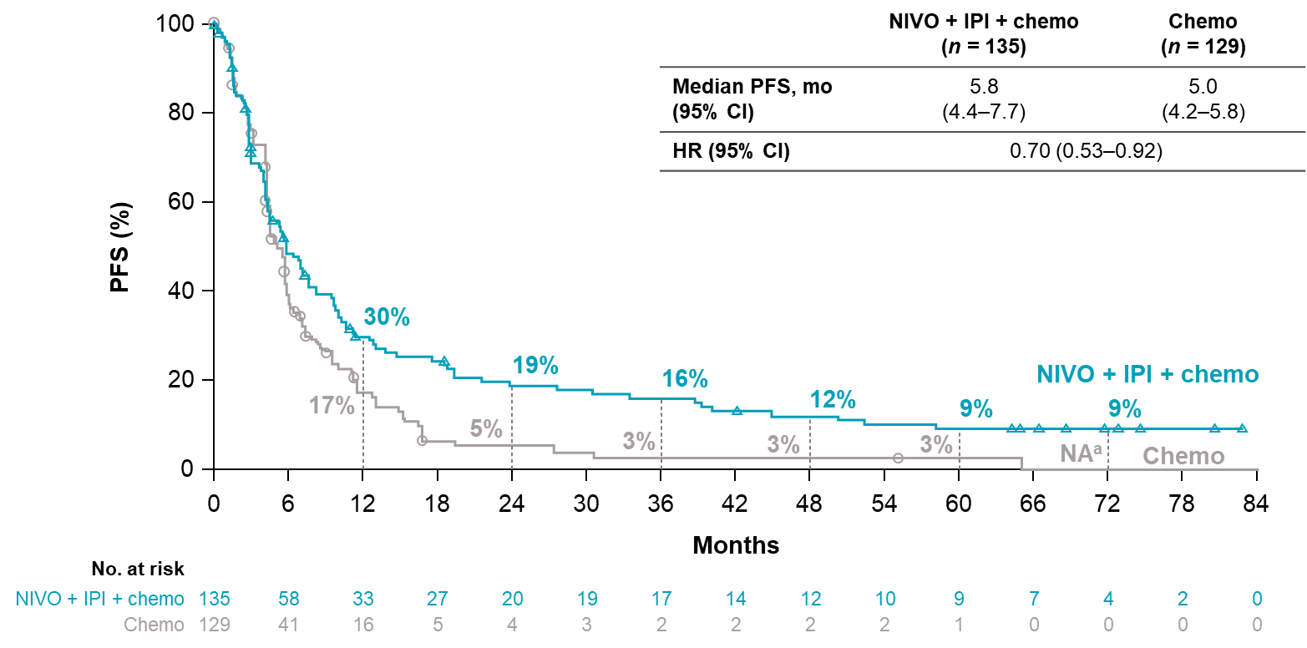
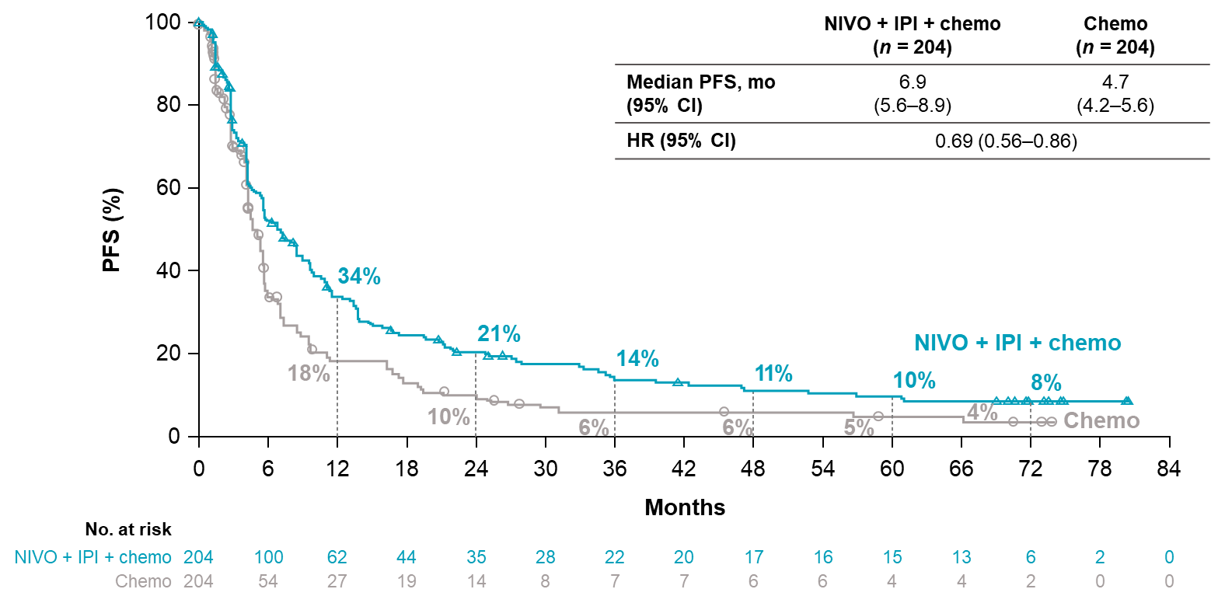
Progression free survival
In PD-L1 <1%
In PD-L1 ≥1%
Chemo: chemotherapy; CI: confidence interval; HR: hazard ratio; IPI: ipilimumab; mo: months; n: number of subjects; NIVO: nivolumab; PD-L1: programmed death ligand 1; PFS: progression free survival.
Carbone D P et al. ESMO 2025. 10(6). https://doi.org/10.1016/j.esmoop.2025.105123. Supplementary appendix.

Slide 8
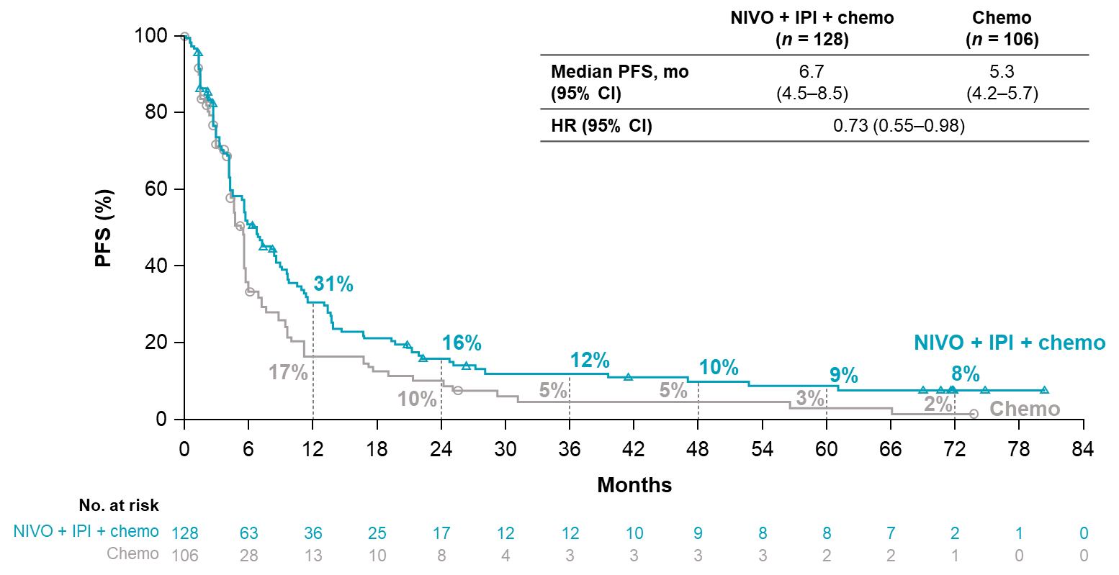
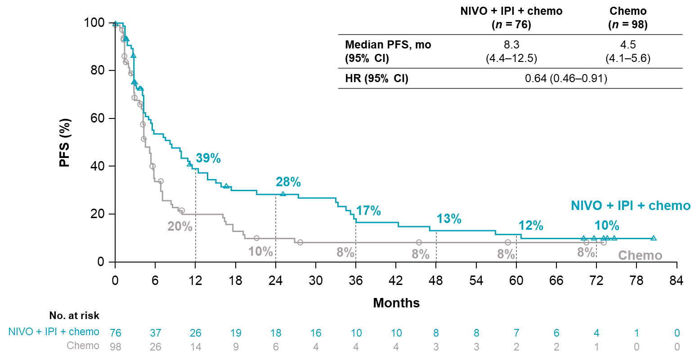
Progression free survival
In PD-L1 1%-49%
In PD-L1 ≥50%
Chemo: chemotherapy; CI: confidence interval; HR: hazard ratio; IPI: ipilimumab; mo: months; n: number of subjects; NIVO: nivolumab; PD-L1: programmed death ligand 1; PFS: progression free survival.
Carbone D P et al. ESMO 2025. 10(6). https://doi.org/10.1016/j.esmoop.2025.105123. Supplementary appendix.

Slide 9
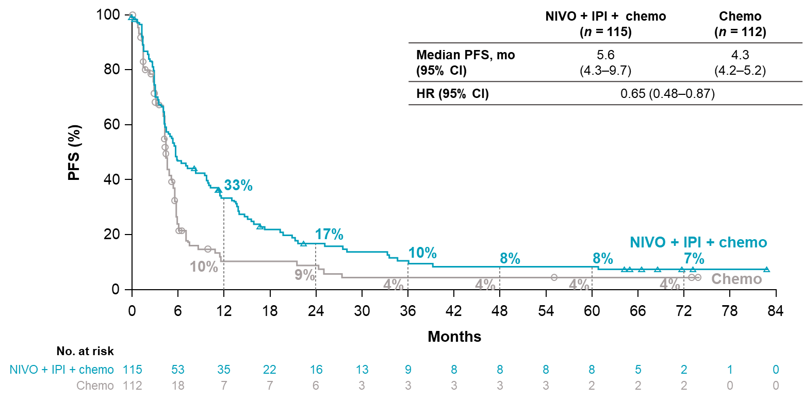
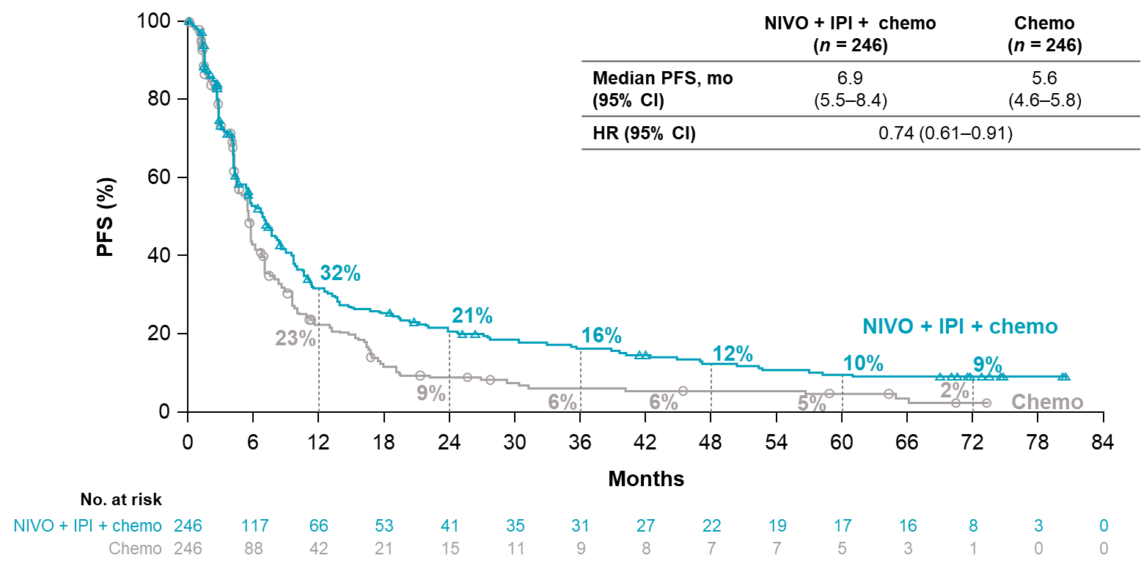
Progression free survival
In SQ
In NSQ
Chemo: chemotherapy; CI: confidence interval; HR: hazard ratio; IPI: ipilimumab; mo: months; n: number of subjects; NIVO: nivolumab; NSQ: non-squamous; PFS: progression free survival; SQ: squamous.
Carbone D P et al. ESMO 2025. 10(6). https://doi.org/10.1016/j.esmoop.2025.105123. Supplementary appendix.

Slide 10
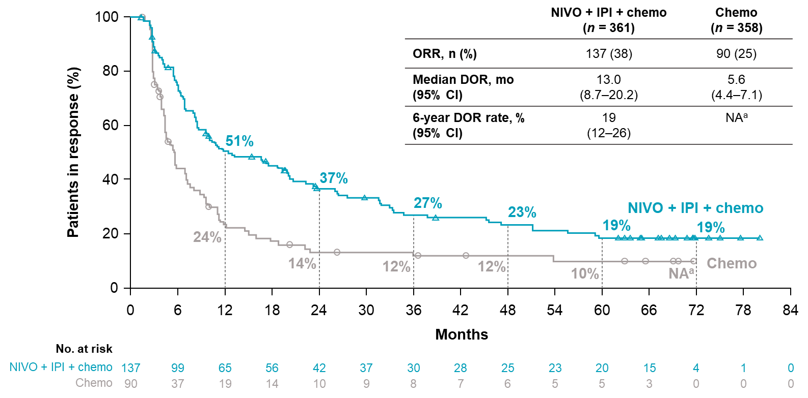
Objective response rate/duration of response
In all randomized patients
ªRate is reported as NA because all patients with continuing response in the chemo arm were censored prior to 72 months.
Chemo: chemotherapy; CI: confidence interval; DOR: duration of response; IPI: ipilimumab; mo: months; n: number of subjects; NA: not available; NIVO: nivolumab; ORR: objective response rate.
Carbone D P et al. ESMO 2025. 10(6). https://doi.org/10.1016/j.esmoop.2025.105123

Slide 11
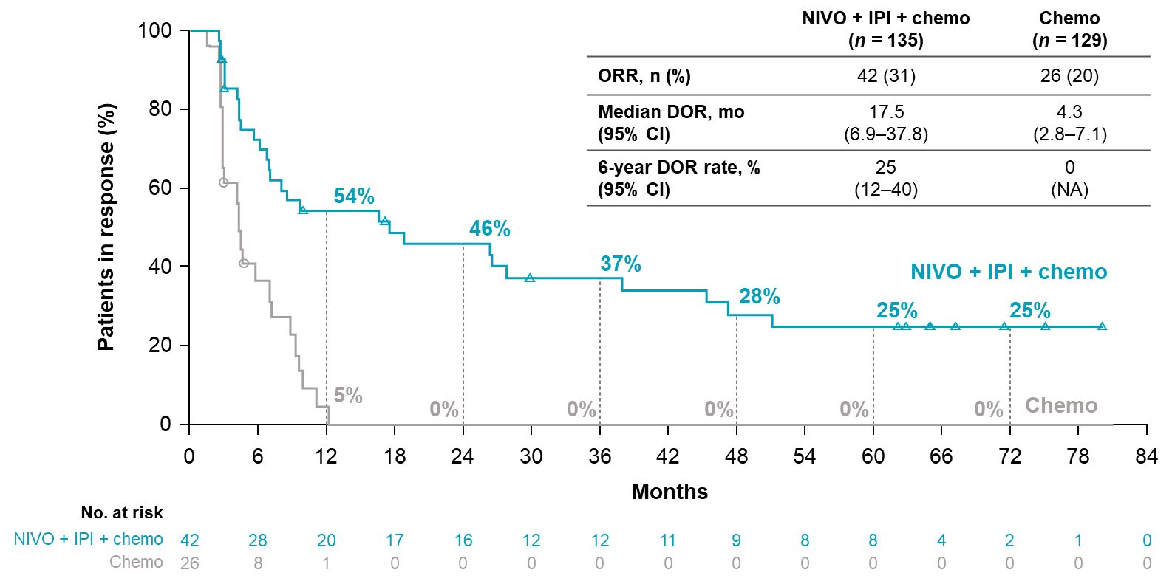
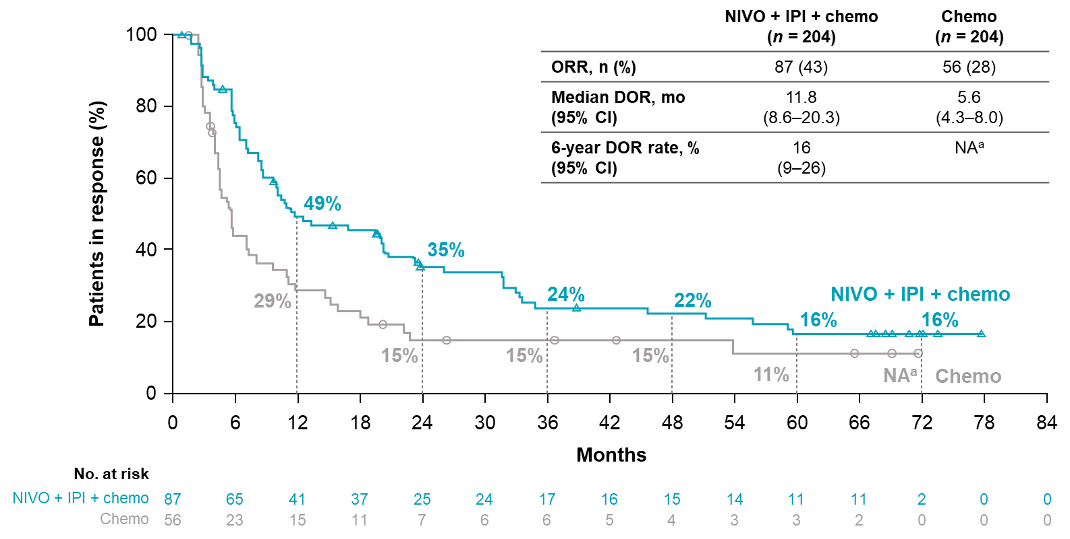
Objective response rate/duration of response
In PD-L1 <1%
In PD-L1 ≥1%
ªRate is reported as NA because all patients with continuing response in the chemo arm were censored prior to 72 months.
Chemo: chemotherapy; CI: confidence interval; DOR: duration of response; IPI: ipilimumab; mo: months; n: number of subjects; NA: not available; NIVO: nivolumab; ORR: objective response rate; PD-L1: programmed death ligand 1.
Carbone D P et al. ESMO 2025. 10(6). https://doi.org/10.1016/j.esmoop.2025.105123

Slide 12
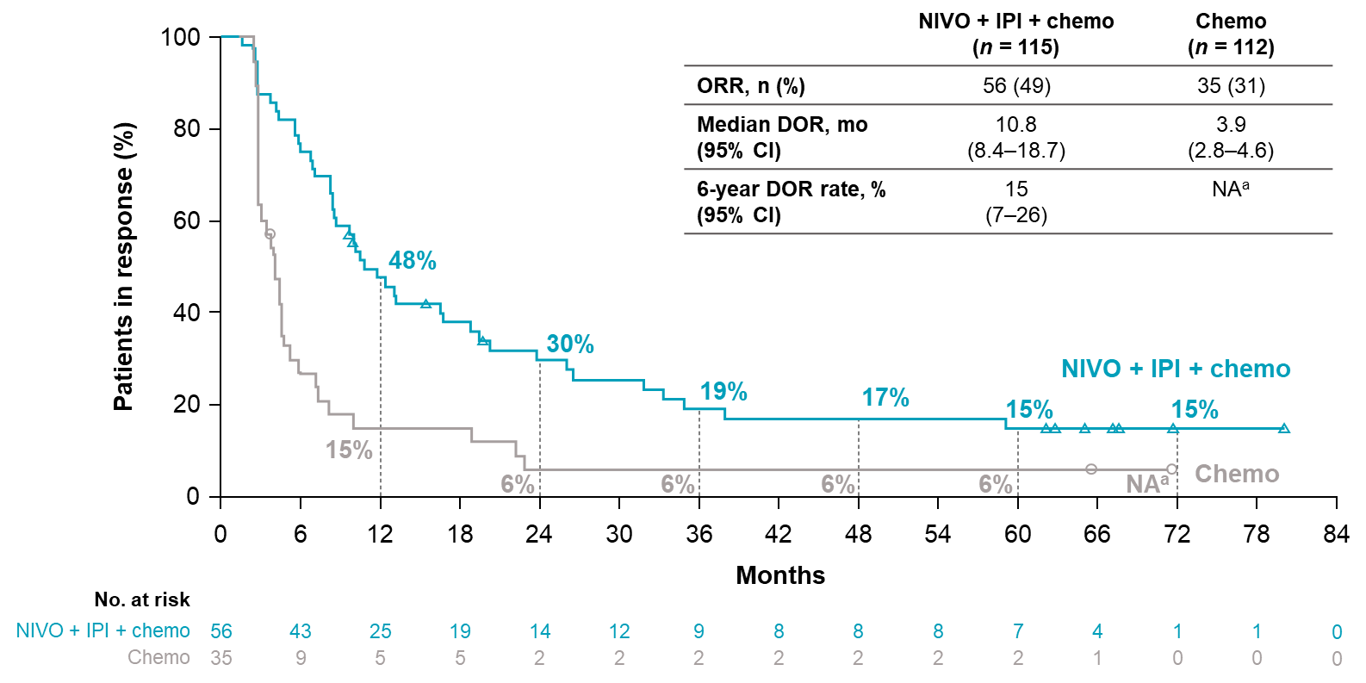
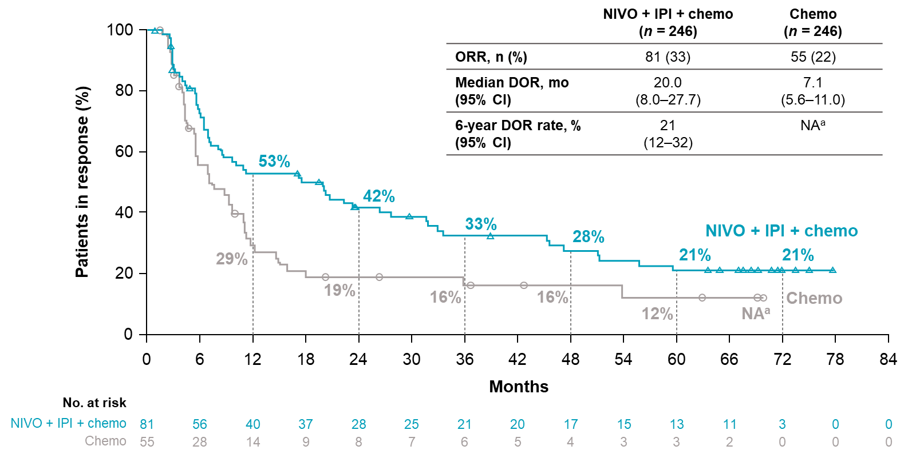
Objective response rate/duration of response
In SQ
In NSQ
ªRate is reported as NA because all patients with continuing response in the chemo arm were censored prior to 72 months.
Chemo: chemotherapy; CI: confidence interval; DOR: duration of response; IPI: ipilimumab; mo: months; n: number of subjects; NA: not available; NIVO: nivolumab; NSQ: non-squamous; ORR: objective response rate; SQ: squamous.
Carbone D P et al. ESMO 2025. 10(6). https://doi.org/10.1016/j.esmoop.2025.105123

Slide 13
Safety summary
 | NIVO + IPI + chemo (n = 358) |  | Chemo (n = 349)
 | Any grade | Grade 3–4 | Any grade | Grade 3–4
All AEs,ª n (%) | 356 (99) | 250 (70) | 342 (98) | 189 (54)
TRAEs,ª n (%) | 328 (92) | 172 (48) | 306 (88) | 133 (38)
All AEs leading to discontinuation,ª n (%) | 116 (32) | 93 (26) | 65 (19) | 45 (13)
All SAEs,ª n (%) | 224 (63) | 177 (49) | 154 (44) | 116 (33)
Treatment-related SAEs,ª n (%) | 109 (30) | 93 (26) | 63 (18) | 52 (15)
Treatment-related deaths,^{b} n (%) | 8 (2)^{c} |  | 6 (2)^{d}
ªIncludes events reported between the first dose and 30 days after the last dose of study drug. ^{b}Includes events reported after the first dose of study drug. ^{c}Due to diarrhea (n = 2) and acute kidney injury, thrombocytopenia, pneumonitis, hepatic toxicity, hepatitis,
and sepsis (n = 1 each). ^{d}Due to sepsis, anemia, pancytopenia, respiratory failure, pulmonary sepsis, and febrile neutropenia (n = 1 each).
AE: adverse events; Chemo: chemotherapy; IPI: ipilimumab; n: number of subjects; NIVO: nivolumab; SAEs: serious adverse events; TRAEs: treatment-related adverse events.
Carbone D P et al. ESMO 2025. 10(6). https://doi.org/10.1016/j.esmoop.2025.105123 Supplementary appendix.

Slide 14
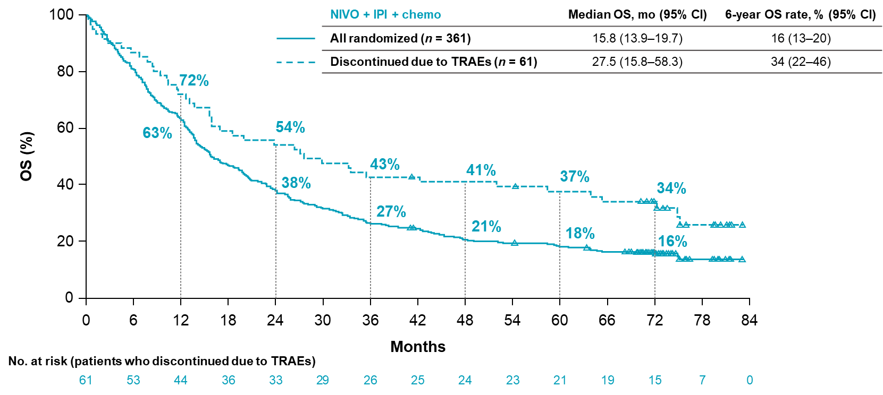
Overall Survival
In patients who discontinued due to TRAEs
Chemo: chemotherapy; CI: confidence interval; HR: hazard ratio; IPI: ipilimumab; mo: months; n: number of subjects; NIVO: nivolumab; OS: overall survival; TRAE: treatment-related adverse event.
Carbone D P et al. ESMO 2025. 10(6). https://doi.org/10.1016/j.esmoop.2025.105123

Slide 15
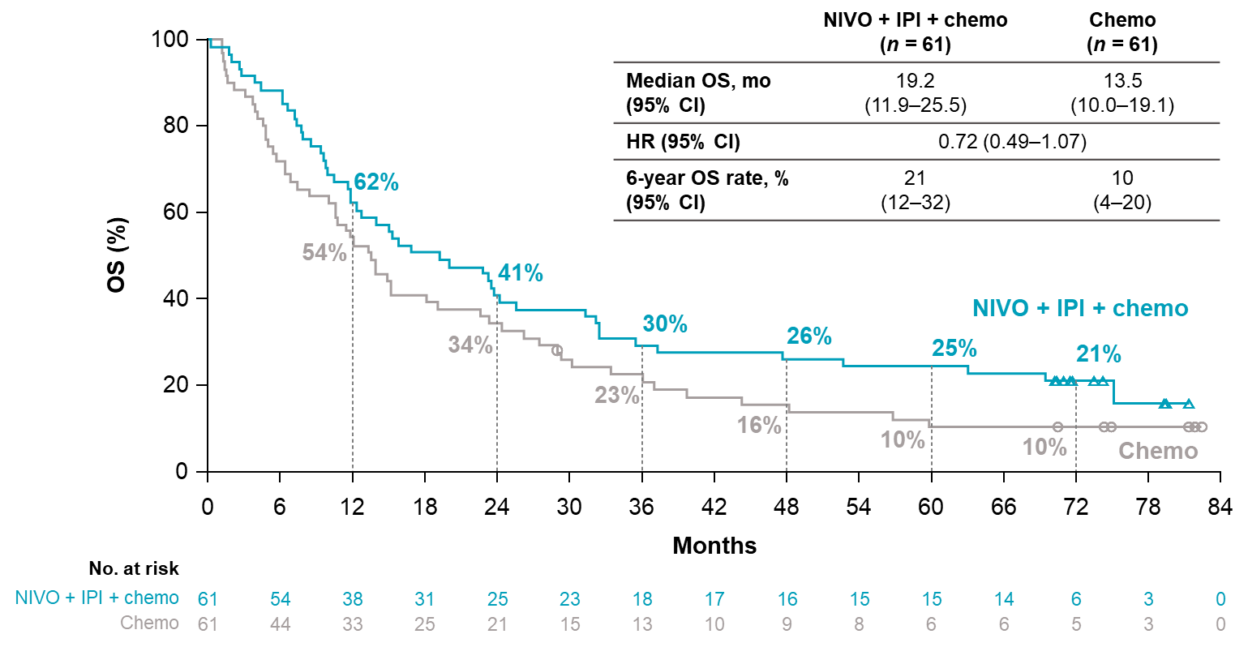
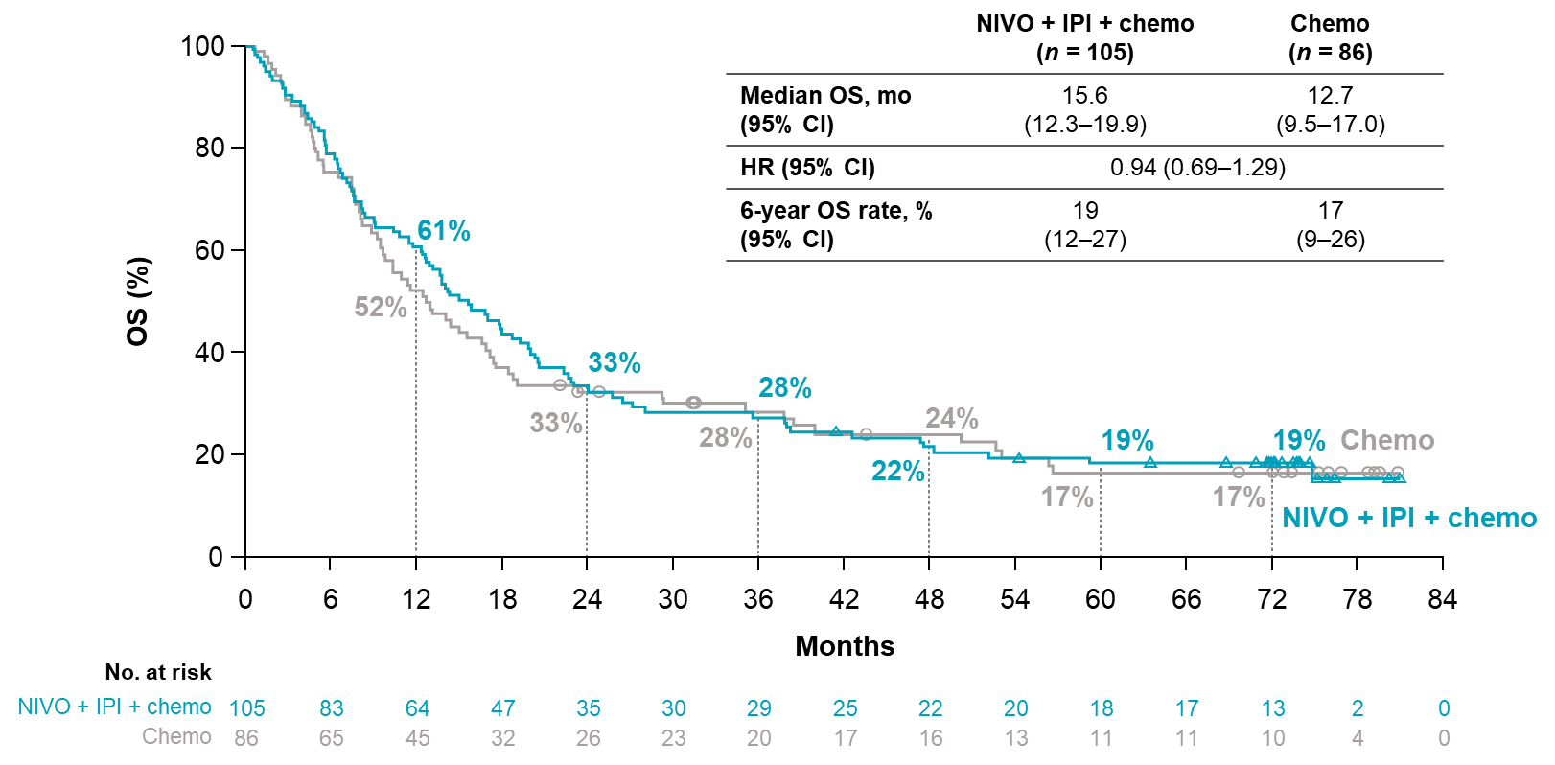
Overall Survival by select mutation status
In KRAS mutation (non-squamous only)
In KRAS wild-type (non-squamous only)
Chemo: chemotherapy; CI: confidence interval; HR: hazard ratio; IPI: ipilimumab; mo: months; n: number of subjects; NIVO: nivolumab; OS: overall survival.
Carbone D P et al. ESMO 2025. 10(6). https://doi.org/10.1016/j.esmoop.2025.105123

Slide 16
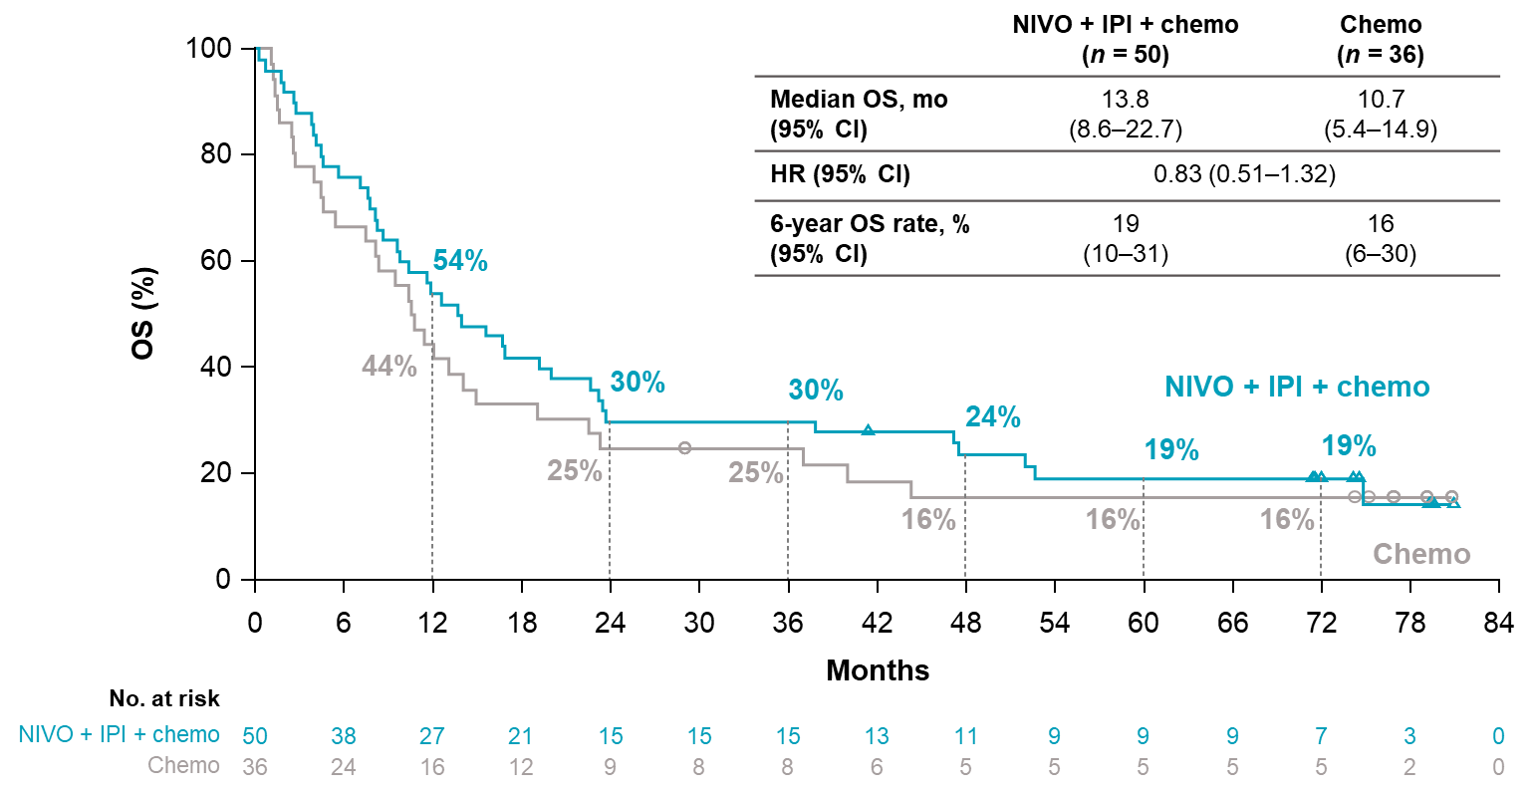
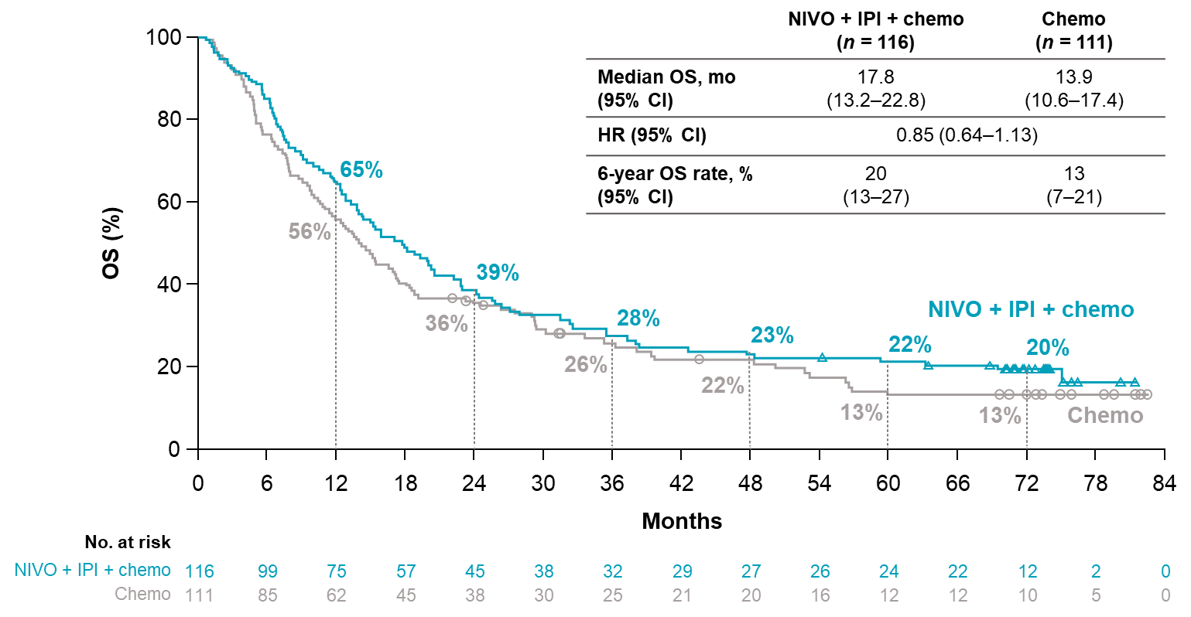
Overall Survival by select mutation status
In STK11 mutation (non-squamous only)
In STK11 wild-type (non-squamous only)
Chemo: chemotherapy; CI: confidence interval; HR: hazard ratio; IPI: ipilimumab; mo: months; n: number of subjects; NIVO: nivolumab; OS: overall survival.
Carbone D P et al. ESMO 2025. 10(6). https://doi.org/10.1016/j.esmoop.2025.105123

Slide 17
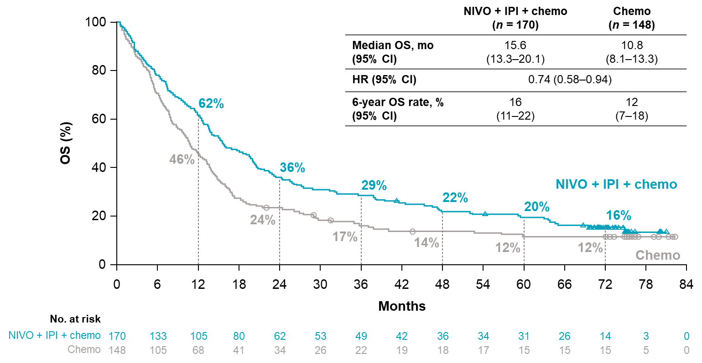
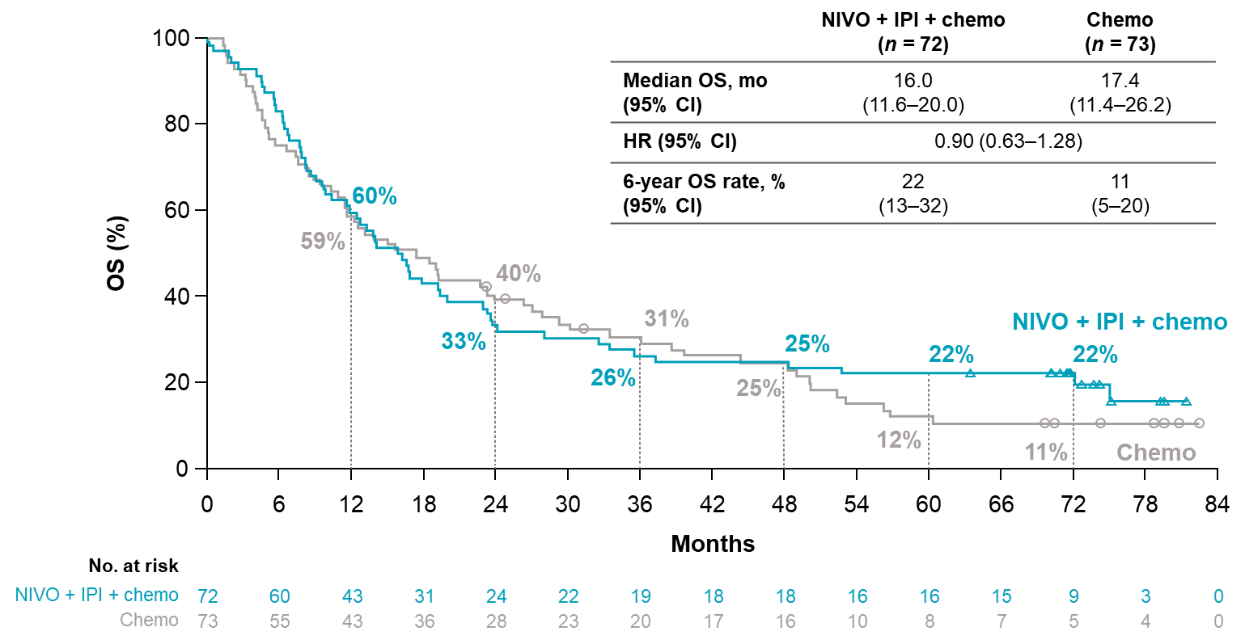
Overall Survival by select mutation status
In TP53 mutation
In TP53 wild-type
Chemo: chemotherapy; CI: confidence interval; HR: hazard ratio; IPI: ipilimumab; mo: months; n: number of subjects; NIVO: nivolumab; OS: overall survival.
Carbone D P et al. ESMO 2025. 10(6). https://doi.org/10.1016/j.esmoop.2025.105123

Slide 18
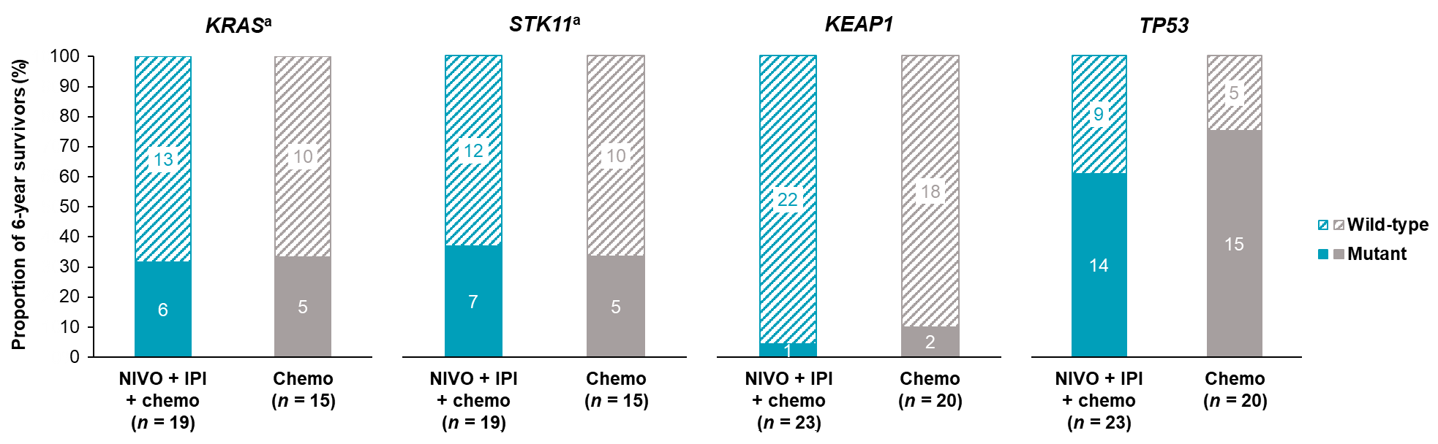
Genomic mutation status in long-term (≥6-year) survivors
ªNon-squamous NSCLC only. Data within the bars represent the number of patients with wild-type or mutant tumors.
Chemo: chemotherapy; IPI: ipilimumab; n: number of subjects; NIVO: nivolumab; NSCLC: non-small cell lung cancer.
Carbone D P et al. ESMO 2025. 10(6). https://doi.org/10.1016/j.esmoop.2025.105123

Slide 19
Treatment disposition in all treated patients
 | NIVO + IPI + chemo (n = 358) | Chemo (n = 349)
Ongoing in the treatment period, n (%) | 0 | 0
Completing the treatment period, n (%) | 49 (14) | 100 (29)
Not completing the treatment period, n (%) Disease progression Study drug toxicity Death Adverse event unrelated to study drug Patient request to discontinue study treatment Patient withdrew consent Lost to follow-up Administrative reasons by sponsor Other Not reported | 309 (86) 184 (51) 70 (20) 7 (2) 31 (9) 2 (1) 4 (1) 0 0 10 (3) 1 (<1) | 249 (71) 174 (50) 24 (7) 1 (<1) 27 (8) 10 (3) 5 (1) 1 (<1) 2 (1) 5 (1) 0
Chemo: chemotherapy; IPI: ipilimumab; n: number of subjects; NIVO: nivolumab.
Carbone D P et al. ESMO 2025. 10(6). https://doi.org/10.1016/j.esmoop.2025.105123. Supplementary appendix.

Slide 20
Duration of treatment in 6-year survivorsª
 | NIVO + IPI + chemo (n = 33) | Chemo (n = 25)
Median duration of treatment, months (range) | 23.3 (1.4–24.3) | 8.7 (0.7–72.0)
ªIncluded 6-year survivors who received ≥1 dose of study treatment only.
Chemo: chemotherapy; IPI: ipilimumab; n: number of subjects; NIVO: nivolumab.
Carbone D P et al. ESMO 2025. 10(6). https://doi.org/10.1016/j.esmoop.2025.105123. Supplementary appendix.

Slide 21
Subsequent therapy in all randomized patients
 | NIVO + IPI + chemo (n = 361) | Chemo (n = 358)
Any subsequent therapy, n (%) | 158 (44) | 199 (56)
Radiotherapy, n (%) | 68 (19) | 62 (17)
Surgery, n (%) | 7 (2) | 3 (1)
Systemic therapy, n (%) | 137 (38) | 178 (50)
Immunotherapy | 29 (8) | 133 (37)
Targeted therapyª | 28 (8) | 30 (8)
Chemo | 128 (36) | 101 (28)
Platinum-doublet chemo | 73 (20) | 23 (6)
ªIncluded 4 (1%) and 6 (2%) patients in the NIVO + IPI + chemo arm and chemo arm, respectively, who received ALK/EGFR tyrosine kinase inhibitors, 24 (7%) and 21 (6%) patients who received VEGFR inhibitors, and 1 (<1%) and 5 (1%) patients who received other targeted therapy agents.
Chemo: chemotherapy; IPI: ipilimumab; n: number of subjects; NIVO: nivolumab.
Carbone D P et al. ESMO 2025. 10(6). https://doi.org/10.1016/j.esmoop.2025.105123. Supplementary appendix.

Slide 22
ORR and BOR per BICR in all randomized patients
 | NIVO + IPI + chemo (n = 361) | Chemo (n = 358)
ORR, % (95% CI) | 38 (33–43) | 25 (21–30)
BOR, n (%)
Complete response | 16 (4) | 5 (1)
Partial response | 121 (34) | 85 (24)
Stable disease | 165 (46) | 186 (52)
Progressive disease | 33 (9) | 43 (12)
Unable to determine | 26 (7) | 38 (11)
Not reported | 0 | 1 (<1)
BICR: blinded independent central review; BOR: best overall response; Chemo: chemotherapy; CI: confidence interval; IPI: ipilimumab; n: number of subjects; NIVO: nivolumab; ORR: objective response rate.
Carbone D P et al. ESMO 2025. 10(6). https://doi.org/10.1016/j.esmoop.2025.105123. Supplementary appendix.

Slide 23
ORR and BOR per BICR by tumor PD-L1 expression
 | PD-L1 <1% |  | PD-L1 ≥1% |  | PD-L1 1%–49% |  | PD-L1 ≥50%
 | NIVO + IPI + chemo (n = 135) | Chemo (n = 129) | NIVO + IPI + chemo (n = 204) | Chemo (n = 204) | NIVO + IPI + chemo (n = 128) | Chemo (n = 106) | NIVO + IPI + chemo (n = 76) | Chemo (n = 98)
ORR, % (95% CI) | 31 (23–40) | 20 (14–28) | 43 (36–50) | 28 (22–34) | 38 (30–47) | 24 (16–33) | 50 (38–62) | 32 (23–42)
BOR, n (%)
Complete response | 6 (4) | 1 (1) | 10 (5) | 3 (2) | 5 (4) | 2 (2) | 5 (7) | 1 (1)
Partial response | 36 (27) | 25 (19) | 77 (38) | 53 (26) | 44 (34) | 23 (22) | 33 (43) | 30 (31)
Stable disease | 68 (50) | 71 (55) | 86 (42) | 101 (50) | 58 (45) | 57 (54) | 28 (37) | 44 (45)
Progressive disease | 12 (9) | 16 (12) | 18 (9) | 25 (12) | 13 (10) | 11 (10) | 5 (7) | 14 (14)
Unable to determine | 13 (10) | 16 (12) | 13 (6) | 21 (10) | 8 (6) | 13 (12) | 5 (7) | 8 (8)
Not reported | 0 | 0 | 0 | 1 (<1) | 0 | 0 | 0 | 1 (1)
BICR: blinded independent central review; BOR: best overall response; Chemo: chemotherapy; CI: confidence interval; IPI: ipilimumab; n: number of subjects; NIVO: nivolumab; ORR: objective response rate; PD-L1: programmed death ligand 1.
Carbone D P et al. ESMO 2025. 10(6). https://doi.org/10.1016/j.esmoop.2025.105123. Supplementary appendix.

Slide 24
ORR and BOR per BICR by tumor histology
 | Squamous |  | Non-squamous
 | NIVO + IPI + chemo (n = 115) | Chemo (n = 112) | NIVO + IPI + chemo (n = 246) | Chemo (n = 246)
ORR, % (95% CI) | 49 (39–58) | 31 (23–41) | 33 (27–39) | 22 (17–28)
BOR, n (%)
Complete response | 8 (7) | 2 (2) | 8 (3) | 3 (1)
Partial response | 48 (42) | 33 (30) | 73 (30) | 52 (21)
Stable disease | 40 (35) | 50 (45) | 125 (51) | 136 (55)
Progressive disease | 9 (8) | 14 (12) | 24 (10) | 29 (12)
Unable to determine | 10 (9) | 13 (12) | 16 (6) | 25 (10)
Not reported | 0 | 0 | 0 | 1 (<1)
BICR: blinded independent central review; BOR: best overall response; Chemo: chemotherapy; CI: confidence interval; IPI: ipilimumab; n: number of subjects; NIVO: nivolumab; SAEs: serious adverse events; ORR: objective response rate.
Carbone D P et al. ESMO 2025. 10(6). https://doi.org/10.1016/j.esmoop.2025.105123. Supplementary appendix.

Slide 25
Baseline characteristics in patients with mutation-evaluable tissue
 | NIVO + IPI + chemo (n = 242) | Chemo (n = 221)
Median age, years (range) | 65 (35–80) | 65 (26–82)
Female, n (%) | 72 (30) | 61 (28)
Geographic region, n (%)
North America | 22 (9) | 15 (7)
Europe | 152 (63) | 138 (62)
Asia | 19 (8) | 19 (9)
Rest of the world | 49 (20) | 49 (22)
ECOG PS, n (%)ª
0 | 73 (30) | 73 (33)
1 | 168 (69) | 148 (67)
Smoking status, n (%)
Current or former | 218 (90) | 194 (88)
Never smoked | 24 (10) | 27 (12)
ªECOG PS was not reported in 1 patient in the NIVO + IPI + chemo arm.
Chemo: chemotherapy; CNS: central nervous system; ECOG PS: Eastern Cooperative Oncology Group performance status; IPI: ipilimumab; n: number of subjects; NIVO: nivolumab; PD-L1: programmed death ligand 1.
Carbone D P et al. ESMO 2025. 10(6). https://doi.org/10.1016/j.esmoop.2025.105123.

Slide 26
Baseline characteristics in patients with mutation-evaluable tissue
 | NIVO + IPI + chemo (n = 242) | Chemo (n = 221)
Metastasis, n (%)
CNS | 42 (17) | 33 (15)
Liver | 44 (18) | 57 (26)
Bone | 65 (27) | 80 (36)
Tumor histology, n (%)
Squamous | 76 (31) | 74 (34)
Non-squamous | 166 (69) | 147 (66)
Tumor PD-L1 expression, n (%)
Non-quantifiable | 6 (2) | 4 (2)
<1% | 90 (37) | 77 (35)
≥1% | 146 (60) | 140 (63)
1%–49% | 95 (39) | 73 (33)
≥50% | 51 (21) | 67 (30)
ªECOG PS was not reported in 1 patient in the NIVO + IPI + chemo arm.
Chemo: chemotherapy; CNS: central nervous system; ECOG PS: Eastern Cooperative Oncology Group performance status; IPI: ipilimumab; n: number of subjects; NIVO: nivolumab; PD-L1: programmed death ligand 1.
Carbone D P et al. ESMO 2025. 10(6). https://doi.org/10.1016/j.esmoop.2025.105123.

Slide 27
OS by KEAP1 mutation status
 | KEAP1 mutant |  | KEAP1 wild-type
 | NIVO + IPI + chemo (n = 18) | Chemo (n = 20) | NIVO + IPI + chemo (n = 224) | Chemo (n = 201)
Median OS, months | 13.2 | 6.9 | 15.8 | 13.1
(95% CI) | (6.6–22.7) | (2.8–11.9) | (13.6–19.4) | (10.7–14.9)
HR (95% CI) | 0.63 (0.32–1.24) |  | 0.81 (0.66–0.99)
Chemo: chemotherapy; CI: confidence interval; HR: hazard ratio; IPI: ipilimumab; n: number of subjects; NIVO: nivolumab; OS: overall survival.
Carbone D P et al. ESMO 2025. 10(6). https://doi.org/10.1016/j.esmoop.2025.105123. Supplementary appendix.

Slide 28
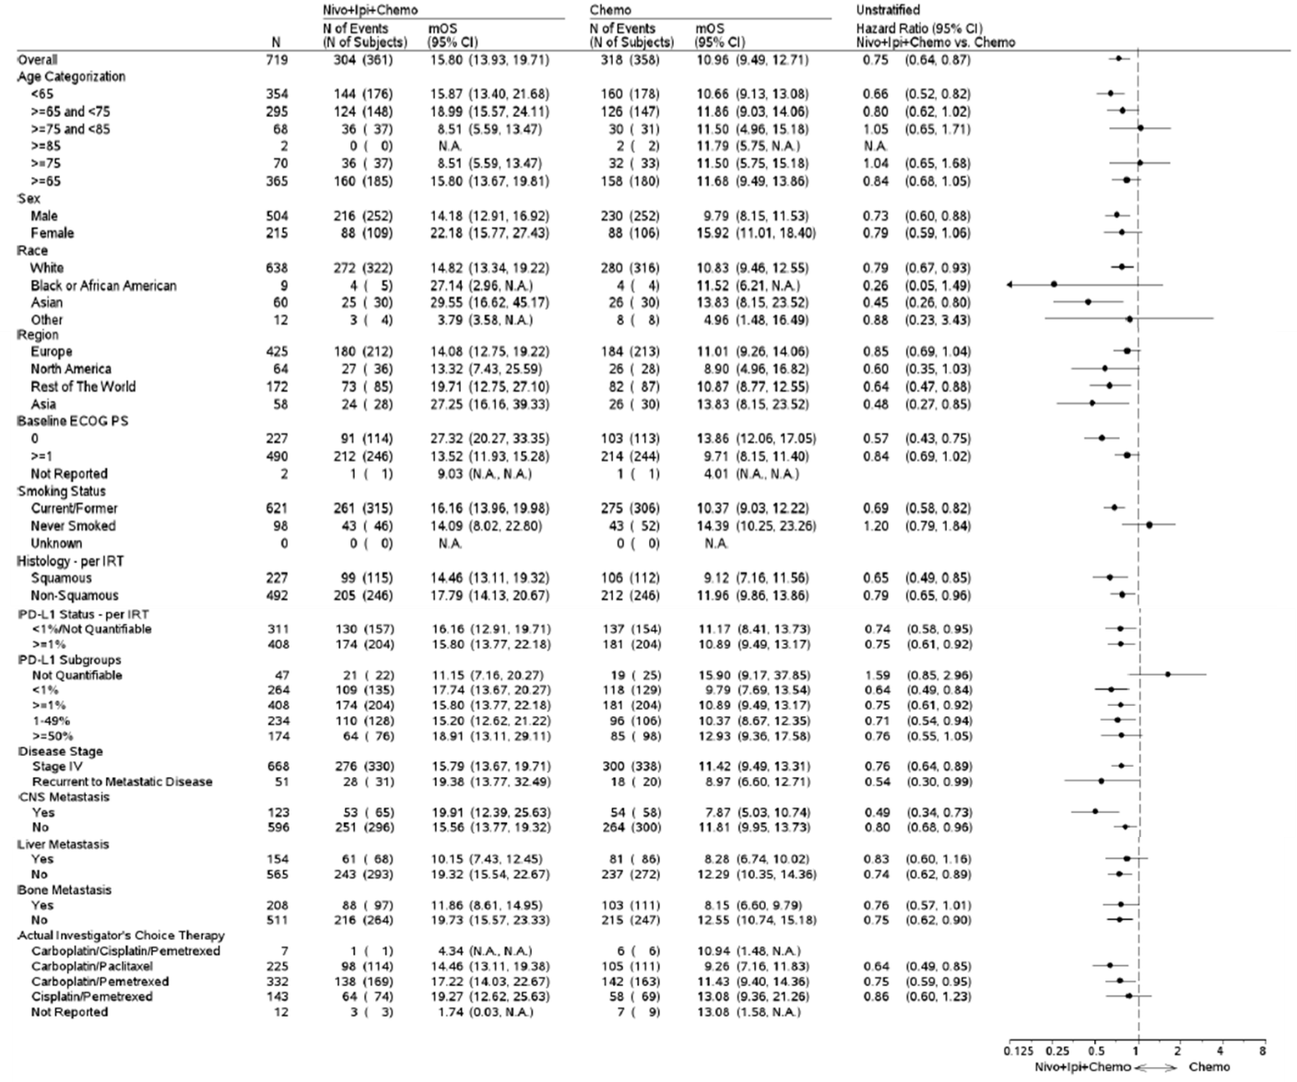
OS in prespecified subgroups
HRs were not computed for subgroup categories (except age, race, region, and sex) with fewer than 10 events per treatment group.
Chemo: chemotherapy; CI: confidence interval; CNS: central nervous system; ECOG PS: Eastern Cooperative Oncology Group performance status; HR: hazard ratio; IPI: ipilimumab; IRT: interactive response technology; m: median; n: number of subjects; NIVO: nivolumab; OS: overall survival; PD-L1: programmed death ligand 1.
Carbone D P et al. ESMO 2025. 10(6). https://doi.org/10.1016/j.esmoop.2025.105123. Supplementary appendix.

Slide 29
OS in prespecified subgroups
HRs were not computed for subgroup categories (except age, race, region, and sex) with fewer than 10 events per treatment group.
Chemo: chemotherapy; CI: confidence interval; CNS: central nervous system; ECOG PS: Eastern Cooperative Oncology Group performance status; HR: hazard ratio; IPI: ipilimumab; IRT: interactive response technology; m: median; n: number of subjects; NIVO: nivolumab; OS: overall survival; PD-L1: programmed death ligand 1.
Carbone D P et al. ESMO 2025. 10(6). https://doi.org/10.1016/j.esmoop.2025.105123. Supplementary appendix.

Slide 30
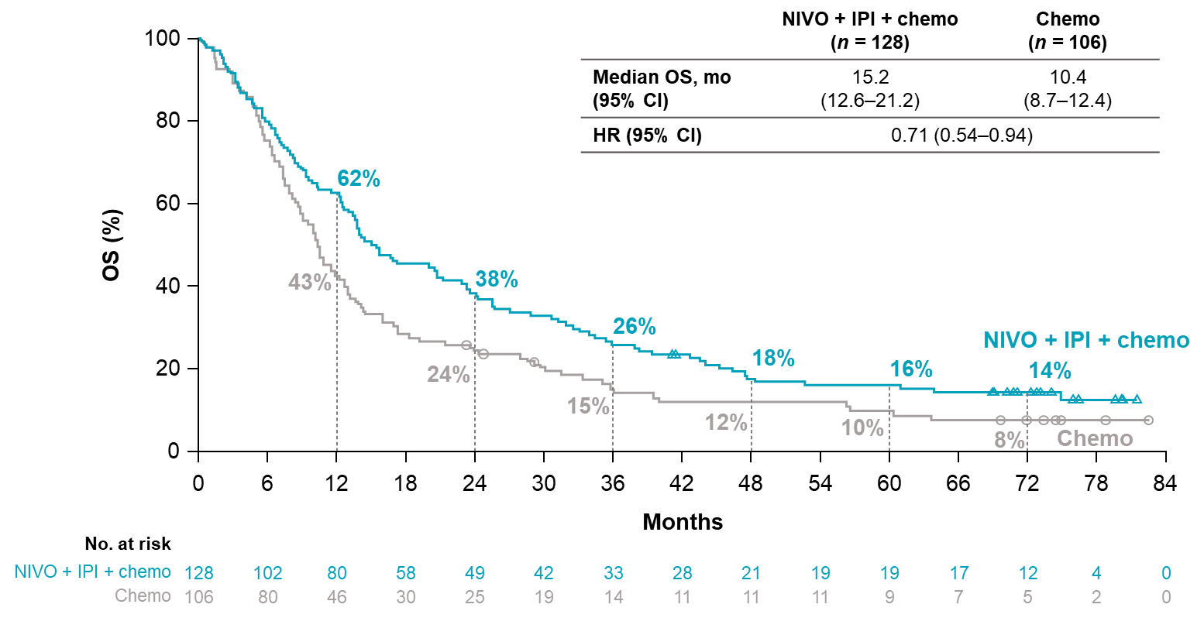
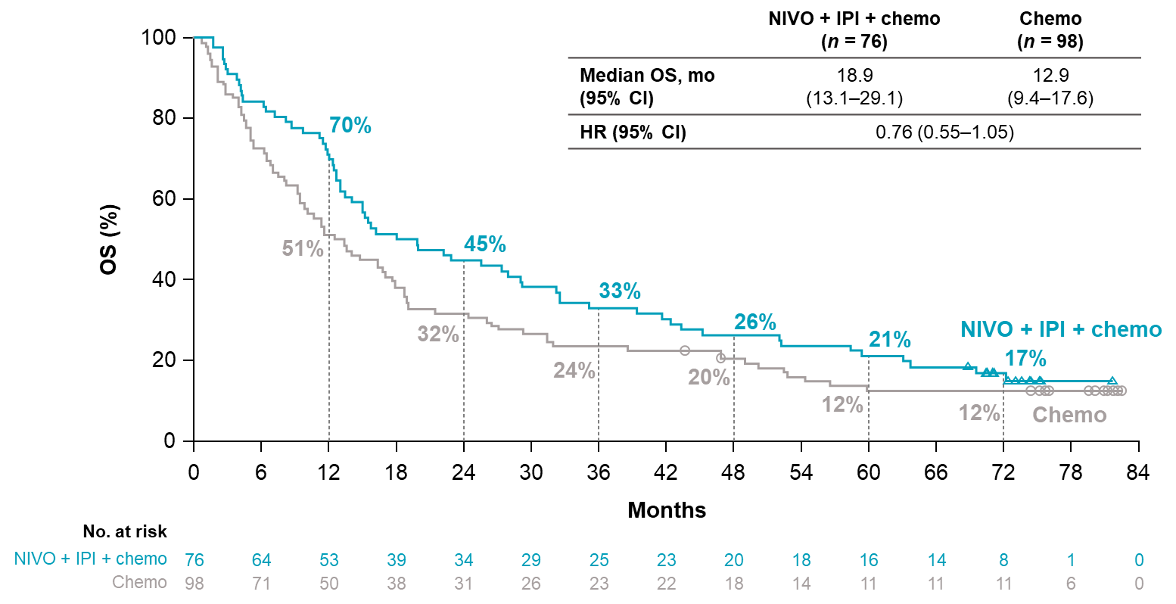
Overall survival in patients with tumor PD-L1 expression
1%-49%
≥50%
Chemo: chemotherapy; CI: confidence interval; HR: hazard ratio; IPI: ipilimumab; mo: months; n: number of subjects; NIVO: nivolumab; OS: overall survival; PD-L1: programmed death ligand 1.
Carbone D P et al. ESMO 2025. 10(6). https://doi.org/10.1016/j.esmoop.2025.105123. Supplementary appendix.

Slide 31
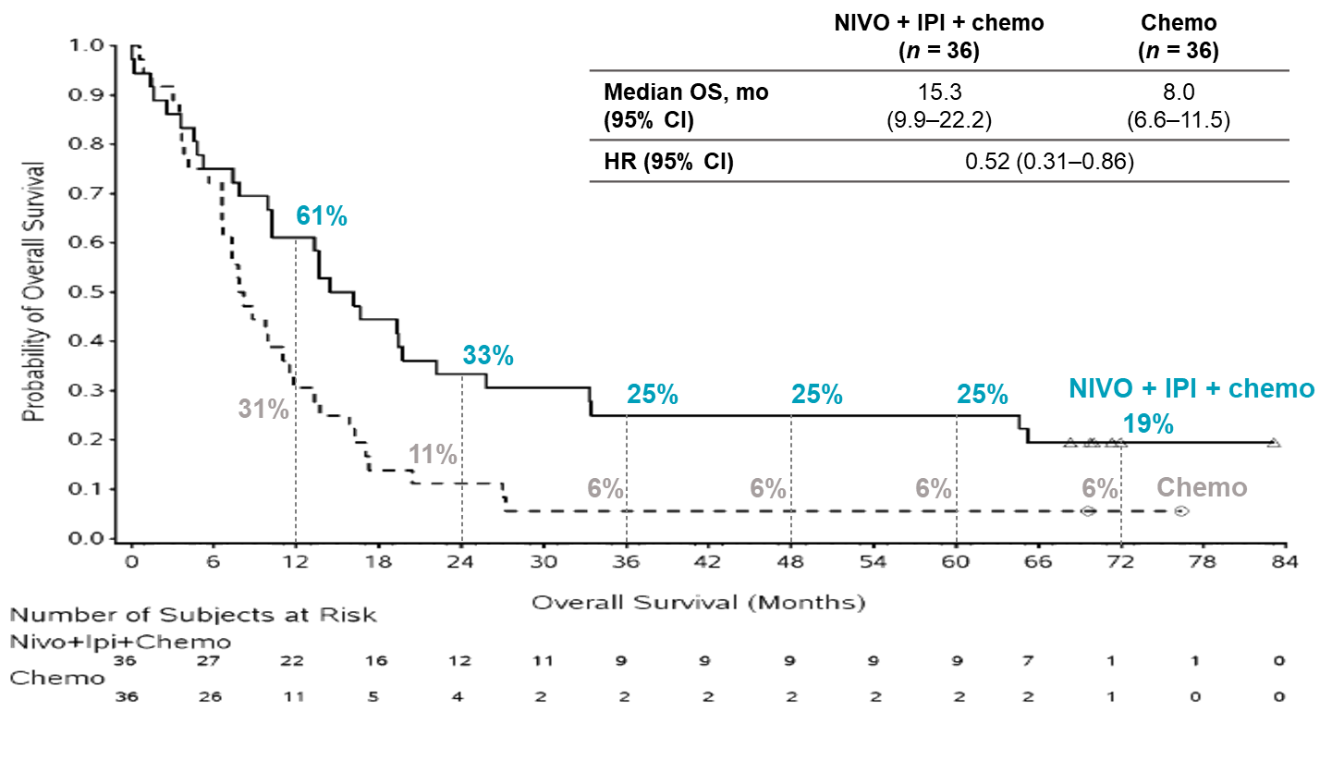
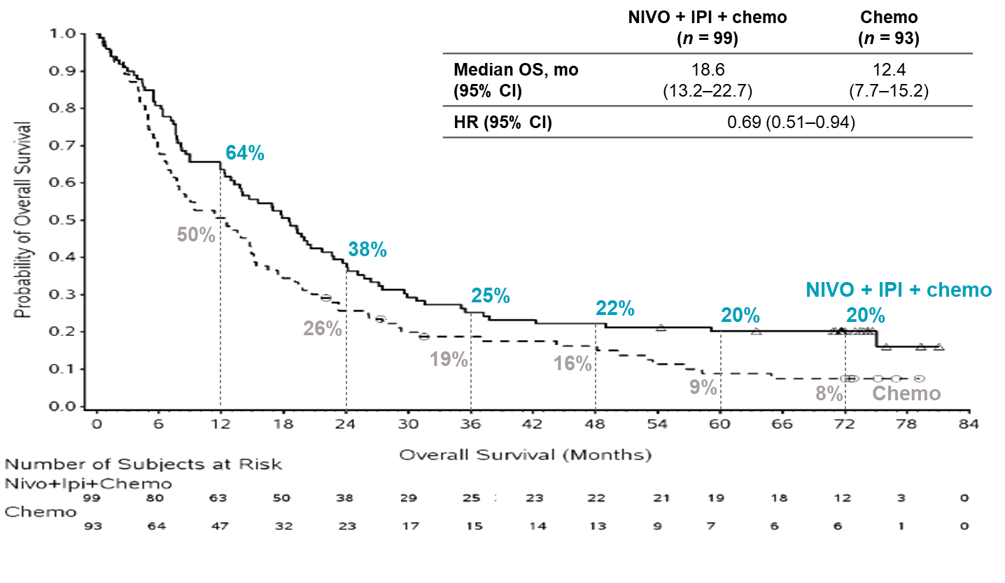
Overall survival in patients with tumor PD-L1 expression <1%
In SQ
In NSQ
Chemo: chemotherapy; CI: confidence interval; HR: hazard ratio; IPI: ipilimumab; mo: months; n: number of subjects; NIVO: nivolumab; NSQ: non-squamous; OS: overall survival; PD-L1: programmed death ligand 1; SQ: squamous.
Carbone D P et al. ESMO 2025. 10(6). https://doi.org/10.1016/j.esmoop.2025.105123. Supplementary appendix.

Slide 32
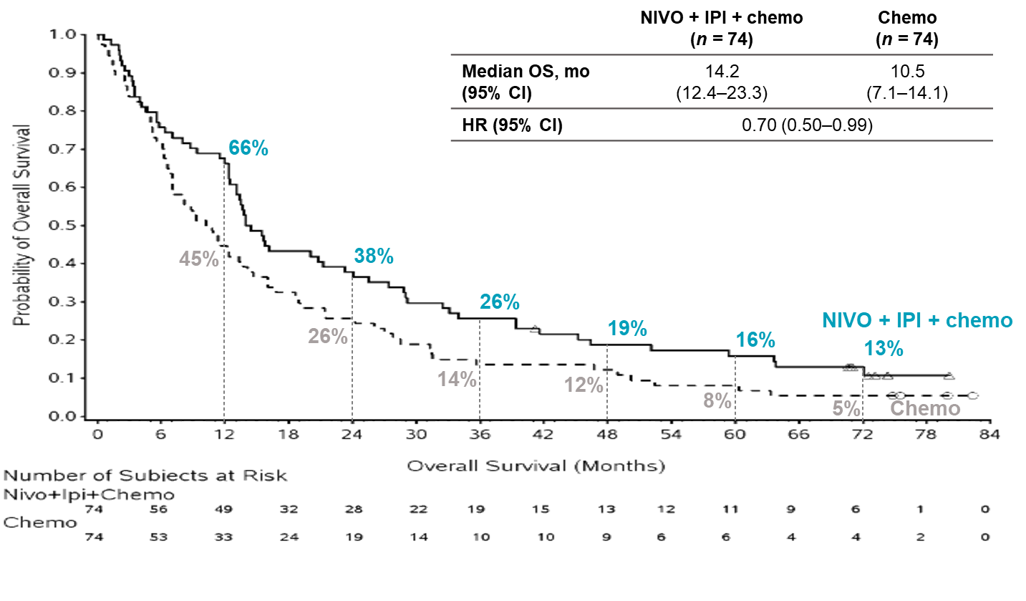
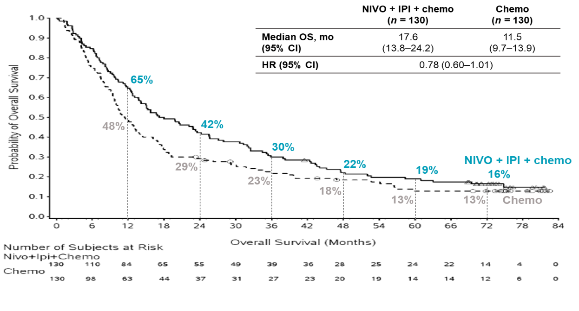
Overall survival in patients with tumor PD-L1 expression ≥1%
In SQ
In NSQ
Chemo: chemotherapy; CI: confidence interval; HR: hazard ratio; IPI: ipilimumab; mo: months; n: number of subjects; NIVO: nivolumab; NSQ: non-squamous; OS: overall survival; PD-L1: programmed death ligand 1; SQ: squamous.
Carbone D P et al. ESMO 2025. 10(6). https://doi.org/10.1016/j.esmoop.2025.105123. Supplementary appendix.

Slide 33
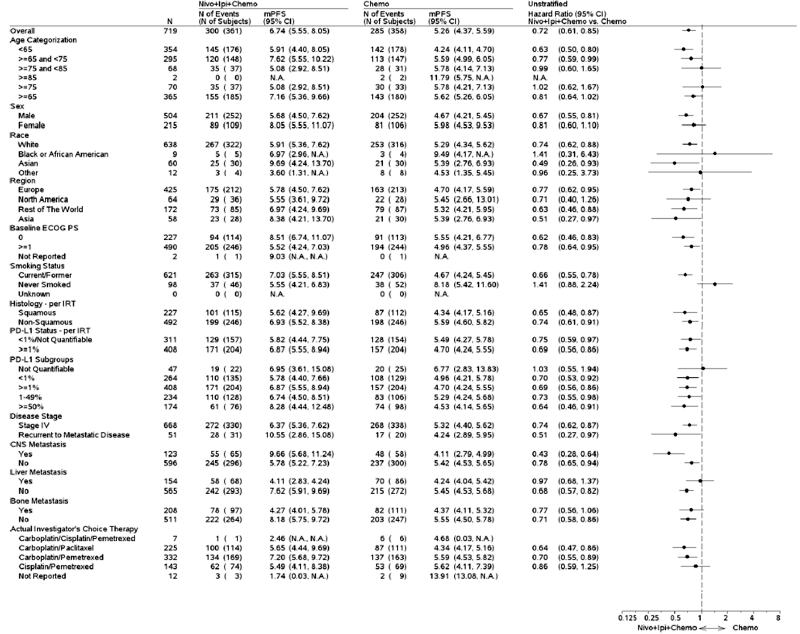
PFS per BICR in prespecified subgroups
HRs were not computed for subgroup categories (except age, race, region, and sex) with fewer than 10 events per treatment group.
BICR: blinded independent central review; Chemo: chemotherapy; CI: confidence interval; CNS: central nervous system; ECOG PS: Eastern Cooperative Oncology Group Performance Status; HR: hazard ratio; IPI: ipilimumab; IRT: interactive response technology; m: median; NIVO: nivolumab; PD-L1: programmed death ligand 1; PFS: progression-free survival.
Carbone D P et al. ESMO 2025. 10(6). https://doi.org/10.1016/j.esmoop.2025.105123

Slide 34

PFS per BICR in prespecified subgroups
HRs were not computed for subgroup categories (except age, race, region, and sex) with fewer than 10 events per treatment group.
BICR: blinded independent central review; Chemo: chemotherapy; CI: confidence interval; CNS: central nervous system; ECOG PS: Eastern Cooperative Oncology Group Performance Status; HR: hazard ratio; IPI: ipilimumab; IRT: interactive response technology; m: median; NIVO: nivolumab; PD-L1: programmed death ligand 1; PFS: progression-free survival.
Carbone D P et al. ESMO 2025. 10(6). https://doi.org/10.1016/j.esmoop.2025.105123

Slide 35
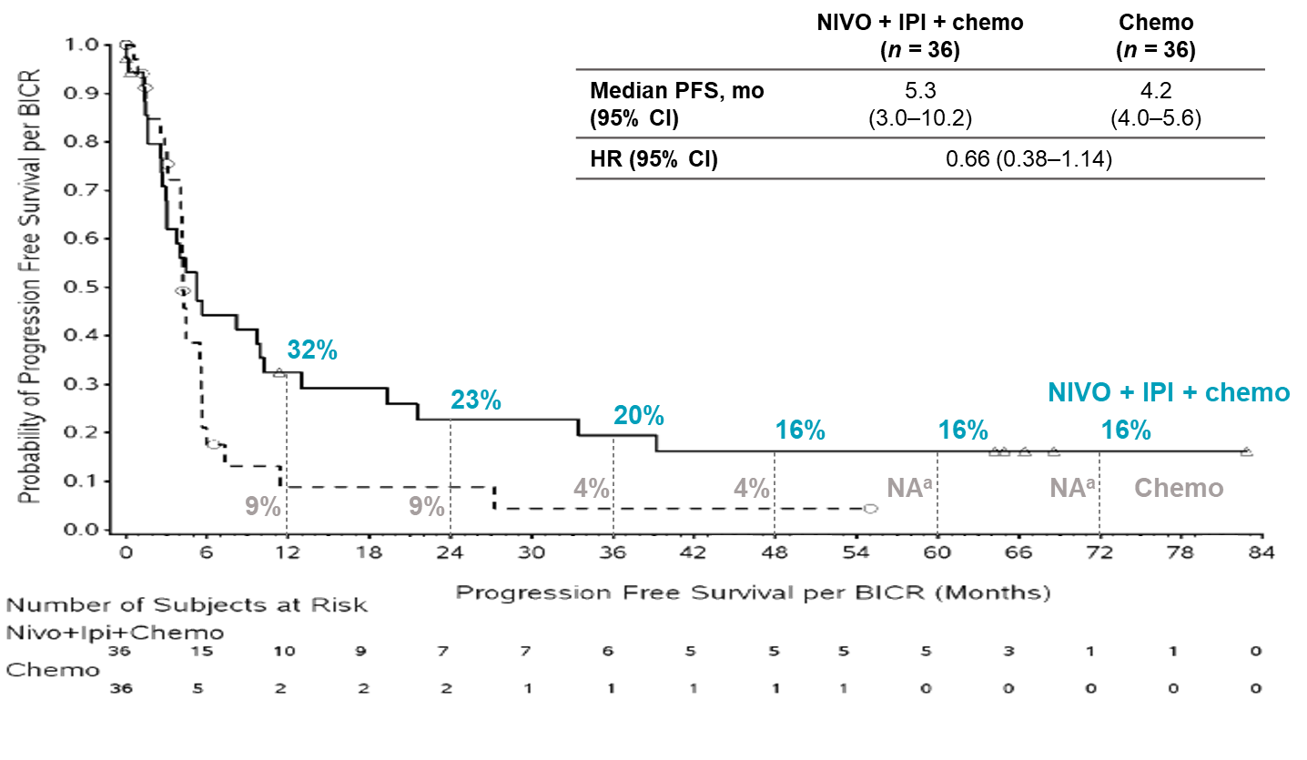
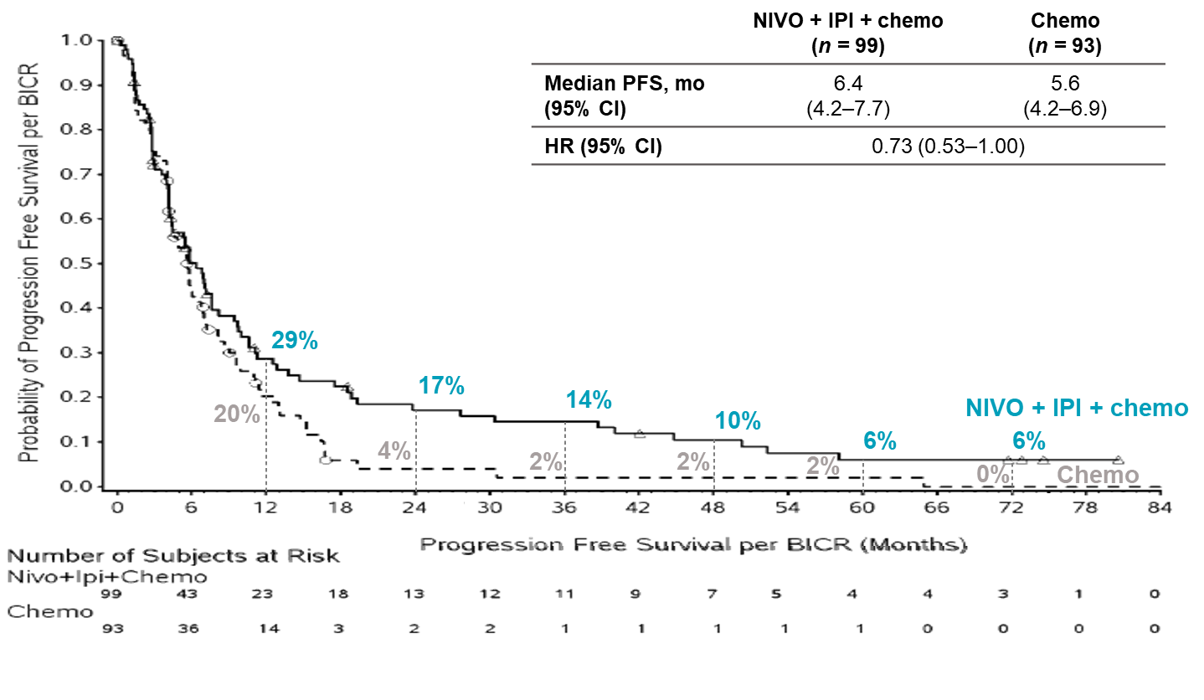
Progression free survival per BICR in patients with tumor PD-L1 expression <1%
In SQ
In NSQ
BICR: blinded independent central review; Chemo: chemotherapy; CI: confidence interval; HR: hazard ratio; IPI: ipilimumab; mo: months; n: number of subjects; NIVO: nivolumab; NSQ: non-squamous; PD-L1: programmed death ligand 1; PFS: progression free survival; SQ: squamous.
Carbone D P et al. ESMO 2025. 10(6). https://doi.org/10.1016/j.esmoop.2025.105123. Supplementary appendix.

Slide 36
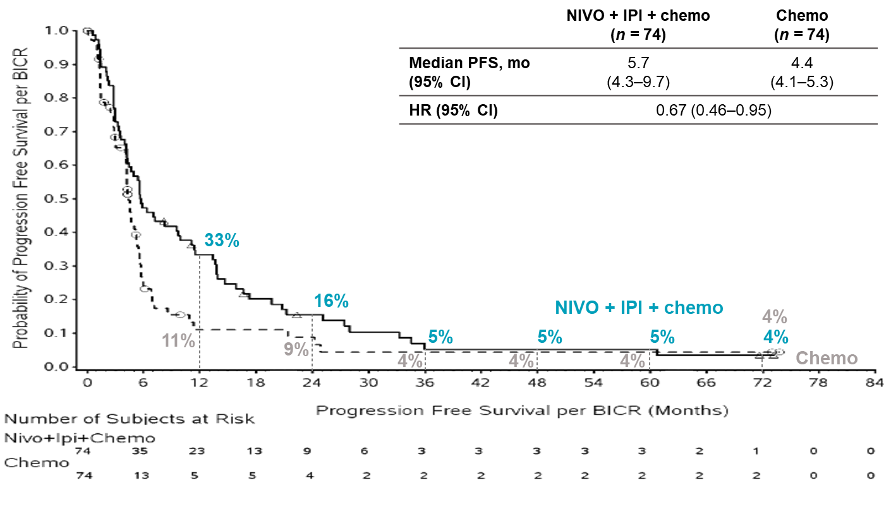
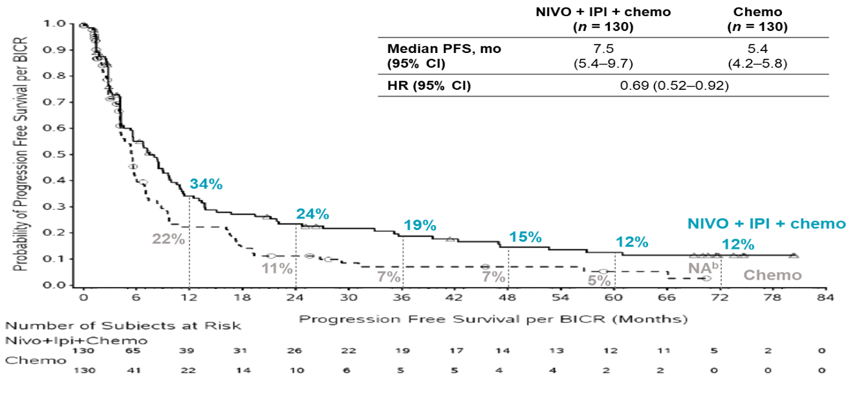
Progression free survival per BICR in patients with tumor PD-L1 expression ≥1%
In SQ
In NSQ
Chemo: chemotherapy; CI: confidence interval; HR: hazard ratio; IPI: ipilimumab; mo: months; n: number of subjects; NIVO: nivolumab; NSQ: non-squamous; PD-L1: programmed death ligand 1; PFS: progression free survival; SQ: squamous.
Carbone D P et al. ESMO 2025. 10(6). https://doi.org/10.1016/j.esmoop.2025.105123. Supplementary appendix.

Slide 37
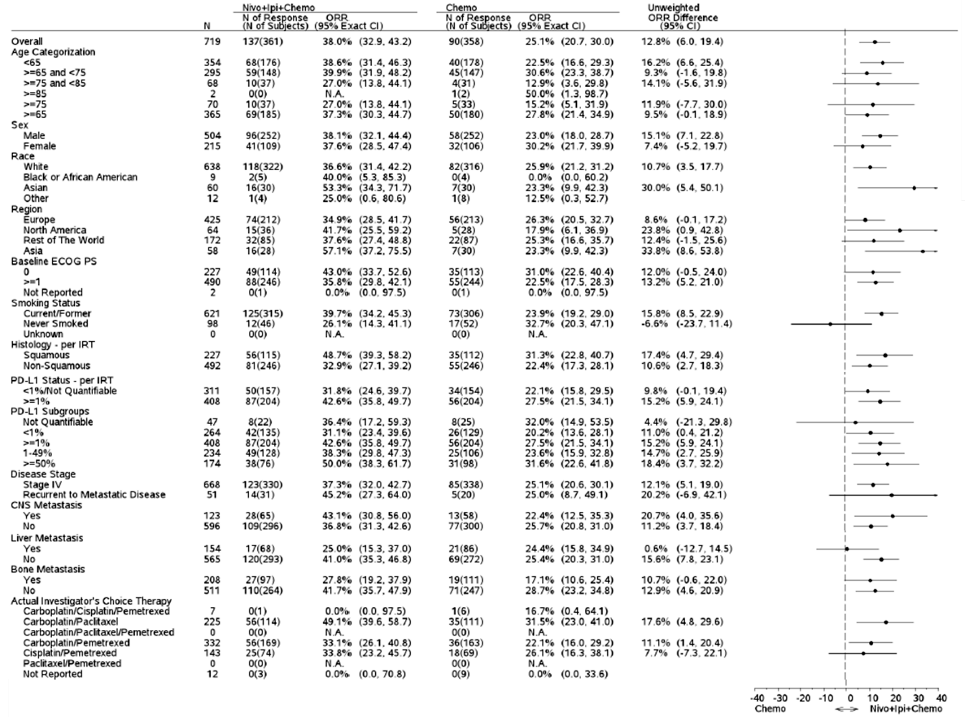
ORR per BICR in prespecified subgroups
BICR: blinded independent central review; Chemo: chemotherapy; CI: confidence interval; CNS: central nervous system; ECOG PS: Eastern Cooperative Oncology Group performance status; IPI: ipilimumab; IRT: interactive response technology; NIVO: nivolumab; ORR: objective response rate; PD-L1: programmed death ligand 1.
Carbone D P et al. ESMO 2025. 10(6). https://doi.org/10.1016/j.esmoop.2025.105123. Supplementary appendix.

Slide 38
ORR per BICR in prespecified subgroups
BICR: blinded independent central review; Chemo: chemotherapy; CI: confidence interval; CNS: central nervous system; ECOG PS: Eastern Cooperative Oncology Group performance status; IPI: ipilimumab; IRT: interactive response technology; NIVO: nivolumab; ORR: objective response rate; PD-L1: programmed death ligand 1.
Carbone D P et al. ESMO 2025. 10(6). https://doi.org/10.1016/j.esmoop.2025.105123. Supplementary appendix.

Slide 39
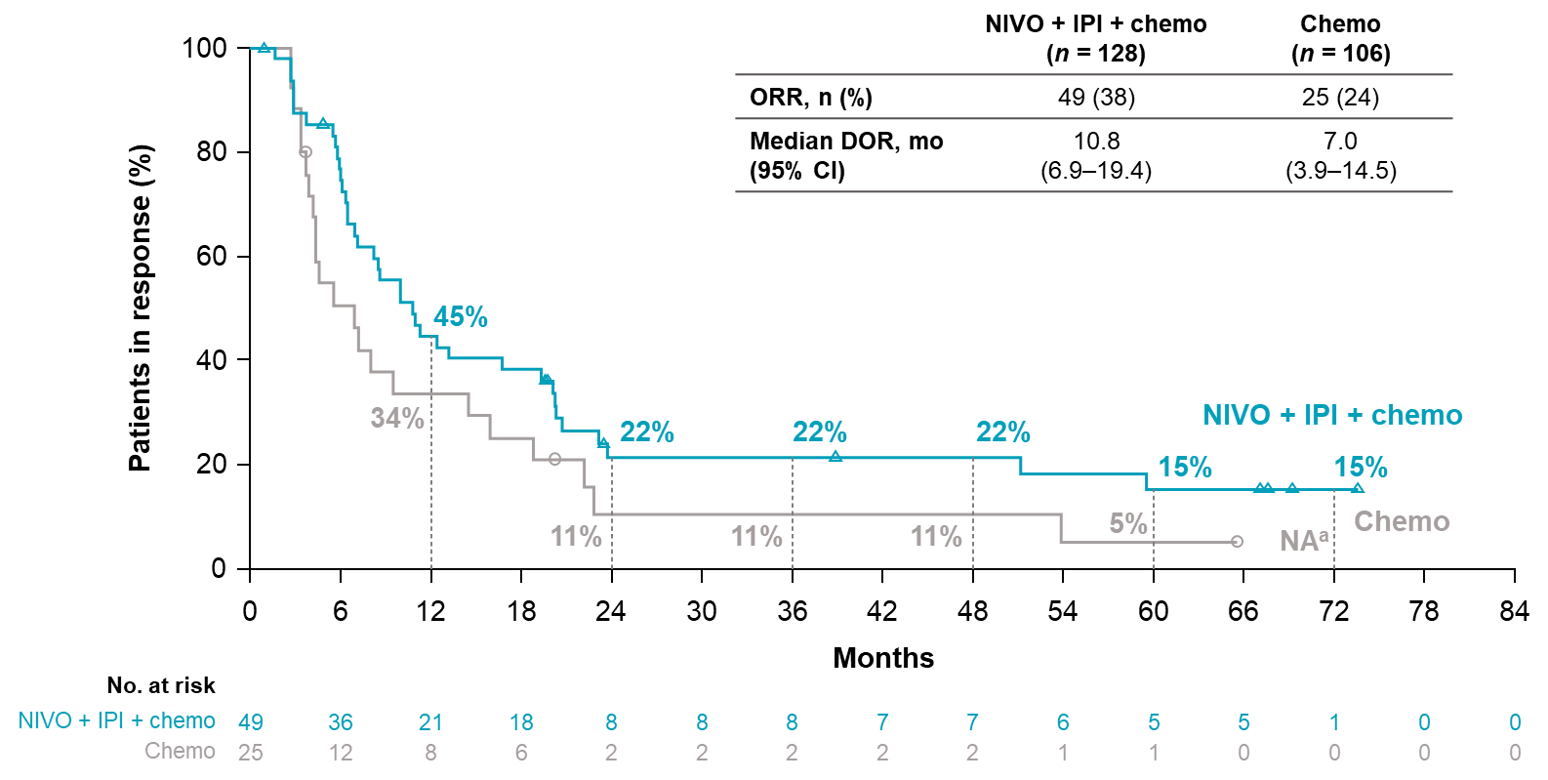
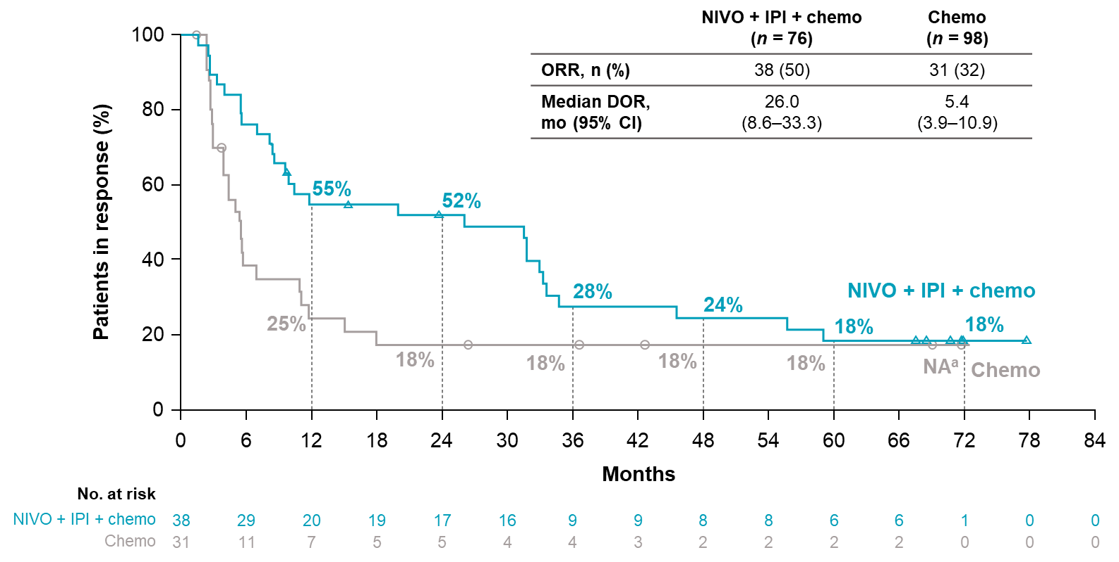
Duration of survival in patients with tumor PD-L1 expression
1%-49%
≥50%
Chemo: chemotherapy; CI: confidence interval; DOR: duration of response; IPI: ipilimumab; n: number of subjects; NIVO: nivolumab; ORR: objective response rate; PD-L1: programmed death ligand 1.
Carbone D P et al. ESMO 2025. 10(6). https://doi.org/10.1016/j.esmoop.2025.105123. Supplementary appendix.

Slide 40
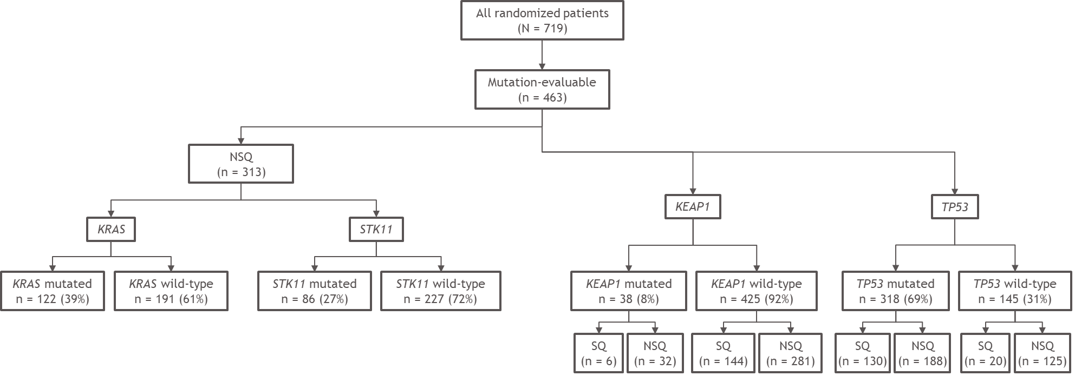
Proportions of patients with mutated and wild-type KRAS, STK11, KEAP1, and TP53
NSQ: non-squamous; SQ: squamous.
Carbone D P et al. ESMO 2025. 10(6). https://doi.org/10.1016/j.esmoop.2025.105123. Supplementary appendix.

Slide 41
Conclusion
In the CheckMate 9LA study, with a median follow-up of 75.8 months, the combination of nivolumab, ipilimumab,
and chemotherapy continued to show durable, long-term survival benefits compared to chemotherapy alone in all randomized patients.
Consistent survival and response benefits were seen with nivolumab plus ipilimumab and chemotherapy regardless
of PD-L1 status or tumor histology.
No new long-term safety issues were seen, and early discontinuation due to TRAEs did not reduce the long-term survival benefit, reinforcing the durability of this regimen.
The results strengthen the role of nivolumab plus ipilimumab with chemotherapy as a standard first-line option in metastatic NSCLC.
NSCLC: non-small cell lung cancer; PD-L1: programmed death ligand 1; TRAEs: treatment-related adverse events.
Carbone D P et al. ESMO 2025. 10(6). https://doi.org/10.1016/j.esmoop.2025.105123

Slide 42
VPI
Verkorte productinformatie OPDIVO 10 mg/ml concentraat voor oplossing voor infusie (IV) en OPDIVO 600 mg oplossing voor injectie (SC).
Samenstelling: IV: Elke ml concentraat voor oplossing voor infusie bevat 10 mg nivolumab. Eén injectieflacon van 4 ml bevat 40 mg nivolumab. Eén injectieflacon van 10 ml bevat 100 mg nivolumab. Eén injectieflacon van 12 ml bevat 120 mg nivolumab. Eén injectieflacon van 24 ml bevat 240 mg nivolumab. SC: Elke ml oplossing voor injectie bevat 120 mg nivolumab. Eén injectieflacon van 5 ml bevat 600 mg nivolumab. Nivolumab wordt geproduceerd in ovariumcellen van de Chinese hamster met behulp van recombinant‑DNA‑techniek. Farmacotherapeutische categorie: antineoplastische middelen, monoklonale antilichamen en antilichaam-geneesmiddelconjugaten, PD-1/PDL-1 (geprogrammeerde celdood-eiwit-1/celdood ligand-1) remmers. Indicaties: Melanoom (IV): als monotherapie of in combinatie met ipilimumab voor de behandeling van gevorderd (inoperabel of gemetastaseerd) melanoom bij volwassenen en adolescenten van 12 jaar en ouder. Melanoom (SC): als monotherapie of in combinatie met ipilimumab voor de behandeling van gevorderd (inoperabel of gemetastaseerd) melanoom bij volwassenen. In vergelijking met nivolumab monotherapie is een toename in progressievrije overleving (PFS) en totale overleving (OS) voor de combinatie van nivolumab met ipilimumab alleen aangetoond bij patiënten met lage tumor-PD-L1-expressie (zie volledige SmPC voor meer informatie). Adjuvante behandeling van melanoom (IV): als monotherapie voor de adjuvante behandeling van volwassenen en adolescenten van 12 jaar en ouder met stadium IIB of IIC melanoom of melanoom waarbij de lymfeklieren betrokken zijn of in geval van gemetastaseerde ziekte waarbij volledige resectie is uitgevoerd. Adjuvante behandeling van melanoom (SC): als monotherapie voor de adjuvante behandeling van volwassenen met stadium IIB of IIC melanoom of melanoom waarbij de lymfeklieren betrokken zijn of in geval van gemetastaseerde ziekte waarbij volledige resectie is uitgevoerd. Niet-kleincellige longkanker (NSCLC) (IV): in combinatie met ipilimumab en 2 cycli van platina bevattende chemotherapie voor de eerstelijnsbehandeling van gemetastaseerde niet-kleincellige longkanker bij volwassenen met tumoren zonder sensibiliserende EGFR‑mutatie of ALK‑translocatie. NSCLC (IV/SC): als monotherapie voor de behandeling van lokaal gevorderde of gemetastaseerde niet-kleincellige longkanker, na eerdere behandeling met chemotherapie bij volwassenen. Neoadjuvante behandeling van NSCLC (IV): OPDIVO is in combinatie met platina bevattende chemotherapie geïndiceerd voor neoadjuvante behandeling van reseceerbare niet‑kleincellige longkanker met een hoog risico op terugkeer van de ziekte bij volwassen patiënten met tumoren met PD‑L1-expressie ≥ 1% (zie rubriek 5.1 voor selectiecriteria). Neoadjuvante en adjuvante behandeling van NSCLC (IV): OPDIVO is in combinatie met platina bevattende chemotherapie als neoadjuvante behandeling, gevolgd door OPDIVO als monotherapie als adjuvante behandeling, geïndiceerd voor de behandeling van reseceerbare niet-kleincellige longkanker met een hoog risico op terugkeer van de ziekte bij volwassen patiënten met tumoren met PD-L1-expressie ≥ 1% (zie rubriek 5.1 voor selectiecriteria). Maligne pleuraal mesothelioom (MPM) (IV):
in combinatie met ipilimumab voor de eerstelijnsbehandeling van volwassen patiënten met inoperabel maligne pleuraal mesothelioom. Niercelcarcinoom (RCC) (IV/SC): als monotherapie voor de behandeling van gevorderd niercelcarcinoom na eerdere behandeling bij volwassenen. In combinatie met ipilimumab geïndiceerd voor de eerstelijnsbehandeling van gevorderd niercelcarcinoom met intermediair/ongunstig risicoprofiel bij volwassenen. In combinatie met cabozantinib voor de eerstelijnsbehandeling van gevorderd niercelcarcinoom bij volwassenen. Klassiek Hodgkin-lymfoom (cHL) (IV): als monotherapie voor de behandeling van volwassen patiënten met recidiverend of refractair cHL na autologe stamceltransplantatie (ASCT) en behandeling met brentuximab vedotin. Plaveiselcelcarcinoom van het hoofd-halsgebied (SCCHN) (IV/SC): als monotherapie voor de behandeling van terugkerend of gemetastaseerd plaveiselcelcarcinoom van het hoofd-halsgebied bij volwassenen die progressie vertonen tijdens of na behandeling met platina bevattende therapie. Urotheelcarcinoom (UC) (IV/SC):
in combinatie met cisplatine en gemcitabine geïndiceerd voor de eerstelijnsbehandeling van volwassen patiënten met inoperabel of gemetastaseerd urotheelcarcinoom. Als monotherapie voor de behandeling van lokaal gevorderd inoperabel of gemetastaseerd urotheelcarcinoom bij volwassenen na falen van eerdere platina bevattende therapie. Adjuvante behandeling van urotheelcarcinoom (IV/SC): Als monotherapie voor de adjuvante behandeling van volwassen patiënten met spierinvasief urotheelcarcinoom (MIUC) met een tumorcel-PD-L1-expressie ≥ 1% en een hoog risico op terugkeer van de ziekte na radicale resectie van MIUC. Mismatch-repair-deficiënt (dMMR) of microsatellietinstabiliteit-hoog (MSI-H) colorectaalcarcinoom (CRC) (IV/SC): in combinatie met ipilimumab voor de behandeling van volwassen patiënten met mismatch-repair-deficiënt of microsatellietinstabiliteit-hoog colorectaalcarcinoom in de volgende omstandigheden: eerstelijnsbehandeling van inoperabel of gemetastaseerd colorectaalcarcinoom; behandeling van gemetastaseerd colorectaalcarcinoom na eerdere behandeling met fluoropyrimidine-bevattende chemotherapie. Oesofageaal plaveiselcelcarcinoom (OSCC) (IV): in combinatie met ipilimumab voor de eerstelijnsbehandeling van volwassen patiënten met inoperabel, gevorderd, terugkerend of gemetastaseerd oesofageaal plaveiselcelcarcinoom met een tumorcel-PD-L1-expressie ≥ 1%. OSCC (IV/SC): in combinatie met fluoropyrimidine- en platina bevattende chemotherapie voor de eerstelijnsbehandeling van volwassen patiënten met inoperabel, gevorderd, terugkerend of gemetastaseerd oesofageaal plaveiselcelcarcinoom met een tumorcel-PD-L1-expressie ≥ 1%. Als monotherapie voor de behandeling van volwassen patiënten met inoperabel, gevorderd, terugkerend of gemetastaseerd oesofageaal plaveiselcelcarcinoom na eerdere behandeling met fluoropyrimidine- en platina bevattende chemotherapie. Adjuvante behandeling van carcinoom van de oesofagus of gastro-oesofageale overgang (OC of GEJC) (IV/SC): als monotherapie voor de adjuvante behandeling van volwassen patiënten met carcinoom van de oesofagus of gastro-oesofageale overgang die na eerdere neoadjuvante behandeling met chemoradiotherapie nog pathologische restziekte hebben. Adenocarcinoom van de maag, gastro-oesofageale overgang (GEJ) of oesofagus (IV/SC): in combinatie met fluoropyrimidine- en platina bevattende chemotherapie geïndiceerd voor de eerstelijnsbehandeling van volwassen patiënten met HER2‑negatief gevorderd of gemetastaseerd adenocarcinoom van de maag, gastro-oesofageale overgang of oesofagus en bij wie de tumoren PD‑L1‑expressie vertonen met een CPS (combined positive score) ≥ 5. Hepatocellulair carcinoom (HCC) (IV): OPDIVO is in combinatie met ipilimumab geïndiceerd voor de eerstelijnsbehandeling van volwassen patiënten met inoperabel of gevorderd hepatocellulair carcinoom. Contra-indicaties: Overgevoeligheid voor de werkzame stof of voor één van de hulpstoffen. Waarschuwingen en voorzorgsmaatregelen: Zie ook SmPC van de andere combinatiemiddelen indien nivolumab in combinatie wordt gebruikt. Bij het beoordelen van de PD-L1-status van de tumor, is het belangrijk dat dat gebeurt op basis van een goed gevalideerde en robuuste methodologie. Bij het beoordelen van de MSI‑H en dMMR‑status van de tumor is het belangrijk dat dat gebeurt op basis van een goed gevalideerde en robuuste methodologie. Immuungerelateerde bijwerkingen traden frequenter op wanneer nivolumab werd toegediend i.c.m. ipilimumab vergeleken met nivolumab als monotherapie. Immuungerelateerde bijwerkingen traden op met vergelijkbare frequenties wanneer OPDIVO werd toegediend in combinatie met cabozantinib, als bij nivolumab als monotherapie. De meeste immuungerelateerde bijwerkingen verbeterden of verdwenen bij de juiste behandeling of aanpassingen in de behandeling. Immuungerelateerde bijwerkingen die optreden in meer dan één lichaamsdeel kunnen gelijktijdig ontstaan. Cardiale en pulmomale bijwerkingen, waaronder longembolie zijn ook gemeld bij combinatiebehandeling. Patiënten moeten vooraf en tijdens de behandeling voortdurend worden gemonitord op cardiale en pulmonale bijwerkingen, alsook op klinische tekenen, symptomen en laboratoriumafwijkingen die kunnen duiden op verstoringen in de elektrolytenbalans en uitdroging. Nivolumab en ipilimumab moeten worden gestaakt in geval van levensbedreigende of opnieuw optredende ernstige cardiale en pulmonale bijwerkingen. Patiënten moeten voortdurend worden gemonitord (tot minstens 5 maanden na de laatste dosis) omdat een bijwerking met nivolumab of nivolumab i.c.m. ipilimumab op ieder moment tijdens of na staken van de behandeling kan optreden. In geval van verdenking van immuungerelateerde bijwerkingen, dient een adequate evaluatie te worden uitgevoerd om etiologie te bevestigen of andere oorzaken uit te sluiten. Op basis van de ernst van de bijwerking, moet nivolumab of nivolumab i.c.m. ipilimumab worden gestaakt en corticosteroïden worden toegediend. Bij patiënten met een reeds bestaande auto‑immuunziekte suggereren gegevens uit observationele studies dat het risico op immuungemedieerde bijwerkingen na behandeling met immuun‑‘checkpoint’‑remmers verhoogd kan zijn in vergelijking met het risico bij patiënten zonder reeds bestaande auto‑immuunziekte. Bovendien kwamen opflakkeringen van de onderliggende auto‑immuunziekte vaak voor, maar de meerderheid was mild en beheersbaar. Nivolumab of nivolumab i.c.m. ipilimumab dient niet te worden hervat zolang de patiënt immunosuppressieve doses corticosteroïden of een andere immunosuppressieve behandeling ontvangt. Om opportunistische infecties te voorkomen bij patiënten die een immunosuppressieve behandeling krijgen, moeten profylactische antibiotica worden gebruikt. Nivolumab of nivolumab i.c.m. ipilimumab moet permanent worden gestaakt in geval van iedere ernstige immuungerelateerde bijwerking die opnieuw optreedt en bij iedere levensbedreigende immuungerelateerde bijwerking. (Gedetailleerde richtlijnen voor het behandelen van immuungerelateerde bijwerkingen staan beschreven in de volledige SmPC.) Ernstige infuusreacties zijn gemeld in klinische onderzoeken met intraveneus nivolumab of intraveneus nivolumab in combinatie met ipilimumab. In geval van ernstige of levensbedreigende infuusreacties moet de infusie met intraveneus nivolumab of intraveneus nivolumab in combinatie met ipilimumab worden gestaakt en een geschikte medische behandeling worden gestart. Artsen dienen bij melanoompatiënten met snel progressieve ziekte, bij niet-plaveiselcel NSCLC-patiënten en SCCHN-patiënten met slechtere prognostische kenmerken en/of aggressieve ziekte en bij OSCC-patiënten rekening te houden met het vertraagde effect van nivolumab voordat behandeling wordt gestart. Bij NSCLC, subtype niet-plaveiselcelcarcinoom, en bij SCCHN werd er binnen 3 maanden een hoger aantal overlijdens waargenomen bij nivolumab vs. docetaxel. Factoren die geassocieerd worden met vroege overlijdens bij NSCLC waren slechtere prognostische factoren en/of aggressievere ziekte, gecombineerd met lage of geen PD-L1-expressie van de tumor. Factoren die geassocieerd worden met vroege overlijdens bij SCCHN waren ECOG performance status, snel progressieve ziekte na eerdere platina bevattende behandeling en hoge tumorlast. Bij OSCC na eerdere eerstelijnsbehandeling met chemotherapie werd een hoger aantal overlijdens waargenomen binnen 2,5 maand vs. chemotherapie. Bij eerstelijnsbehandeling van OSCC werd binnen 4 maanden een hoger aantal overlijdens waargenomen bij nivolumab in combinatie met ipilimumab vergeleken met chemotherapie. In vergelijking met nivolumab monotherapie is er alleen een toename in PFS voor nivolumab i.c.m. ipilimumab aangetoond bij melanoompatiënten met lage tumor-PD-L1-expressie. De verbetering in OS was gelijk voor nivolumab in combinatie met ipilimumab en nivolumab als monotherapie bij patiënten met een hoge tumor-PD-L1-expressie (PD- L1 ≥ 1%). Voor aanvang van de behandeling met de combinatie, worden artsen geadviseerd om de individuele patiënt- en tumorkarakteristieken nauwkeurig te beoordelen, waarbij de waargenomen voordelen en toxiciteit van de combinatie in vergelijking met nivolumab monotherapie in overweging moeten worden genomen. Wanneer nivolumab in combinatie met cabozantinib werd gegeven, werden hogere aantallen graad 3 en 4 ALAT- en ASAT-verhogingen gemeld in vergelijking met nivolumab monotherapie. Leverenzymen moeten vóór aanvang en periodiek gedurende de behandeling worden gecontroleerd. Complicaties van allogene HSCT bij cHL: Er zijn gevallen van acute “graft-versus-host-disease” (GVHD) en aan de transplantatie gerelateerde mortaliteit (TRM) waargenomen tijdens de follow-up van patiënten met cHL die een allogene HSCT hebben ondergaan na eerdere blootstelling aan intraveneus nivolumab. Bij patiënten die behandeld waren met nivolumab na allogene HSCT, werd snel optredende en ernstige GVHD in post-marketing setting gemeld, waarvan in sommige gevallen met fatale afloop. De behandeling met nivolumab kan het risico op ernstige GVHD en overlijden verhogen bij patiënten die eerdere allogene HSCT hebben ondergaan, voornamelijk bij een medische voorgeschiedenis van GVHD. (IV): Elke ml van dit geneesmiddel bevat 0,1 mmol (of 2,5 mg) natrium. Inname van natrium kan variëren als natriumchloride wordt gebruikt voor de verdunningsstappen. Dit dient in overweging te worden genomen bij de behandeling van patiënten op een natriumarm dieet. (SC): Dit geneesmiddel bevat 2,5 mg polysorbaat 80 in elke injectieflacon van 5 ml. Dit komt overeen met 5 mg/10 ml. Polysorbaten kunnen allergische reacties veroorzaken. Bijwerkingen: Nivolumab monotherapie (IV/SC): de meest gemelde bijwerkingen zijn (≥ 10%) vermoeidheid (44%), skeletspierstelselpijn (28%), diarree (26%), rash (24%), hoesten (22%), misselijkheid (22%), pruritus (19%), verminderde eetlust (17%), artralgie (17%), constipatie (16%), dyspneu (16%), buikpijn (15%), bovensteluchtweginfectie (15%), pyrexie (13%), hoofdpijn (13%), anemie (13%) en braken (12%). De meerderheid van de bijwerkingen was licht tot matig in ernst (graad 1 of 2). De incidentie van bijwerkingen van graad 3‑5 was 44%, met 0,3% fatale bijwerkingen die zijn toe te schrijven aan het onderzoeksmiddel. Met een minimale follow‑up van 63 maanden in NSCLC zijn er geen nieuwe veiligheidssignalen gevonden. De veiligheid van subcutaan toegediende nivolumab was vergelijkbaar met het bekende veiligheidsprofiel van de intraveneuze vorm van nivolumab, met een extra bijwerking van reactie op de injectieplaats (7% in de groep met subcutaan nivolumab (n = 247) vergeleken met 0% in de groep met intraveneus nivolumab (n = 245)). Nivolumab in combinatie met ipilimumab (met of zonder chemotherapie) (IV/SC): de meest voorkomende bijwerkingen (≥ 10%) waren vermoeidheid (47%), diarree (35%), rash (37%), misselijkheid (27%), pruritus (29%), skeletspierstelselpijn (26%), pyrexie (23%), verminderde eetlust (22%), hoesten (21%), buikpijn (18%), braken (18%), constipatie (18%), artralgie (18%), dyspneu (17%), hypothyreoïdie (16%), hoofdpijn (15%), bovensteluchtweginfectie (13%), oedeem (13%) en duizeligheid (10%). De incidentie van bijwerkingen van graad 3‑5 was 66% voor nivolumab in combinatie met ipilimumab (met of zonder chemotherapie), waarvan 1,0% van de fatale bijwerkingen die zijn toe te schrijven aan het onderzoeksmiddel. Onder patiënten die behandeld werden met nivolumab 1 mg/kg in combinatie met ipilimumab 3 mg/kg voor melanoom, werden vermoeidheid (62%), rash (57%), diarree (52%), misselijkheid (42%), pruritus (40%), pyrexie (36%) en hoofdpijn (26%) gemeld met een incidentie van ≥ 10% hoger dan de incidenties gerapporteerd in de gepoolde dataset van nivolumab in combinatie met ipilimumab (met of zonder chemotherapie). Onder patiënten die behandeld werden met nivolumab 360 mg in combinatie met ipilimumab 1 mg/kg en chemotherapie voor NSCLC, werden anemie (32%) en neutropenie (15%) gemeld met een incidentie van ≥ 10% hoger dan de incidenties gerapporteerd in de gepoolde dataset van nivolumab in combinatie met ipilimumab (met of zonder chemotherapie). Nivolumab in combinatie met chemotherapie (IV/SC): De vaakst gemelde bijwerkingen zijn (≥ 10%) misselijkheid (48%), vermoeidheid (40%), perifere neuropathie (33%), verminderde eetlust (31%), constipatie (31%), diarree (28%), braken (24%), rash (19%), buikpijn (18%), stomatitis (18%), skeletspierstelselpijn (18%), pyrexie (16%), hoesten (13%), oedeem (waaronder perifeer oedeem) (12%) en pruritus (11%). De incidentie van graad 3‑5 bijwerkingen was 69% voor nivolumab in combinatie met chemotherapie, waarvan 1,2% bijwerkingen met fatale afloop die konden worden toegeschreven aan nivolumab in combinatie met chemotherapie. Mediane duur van de behandeling was 6,14 maanden (95%-BI: 5,78; 6,60) voor nivolumab in combinatie met chemotherapie. Voor reseceerbare NSCLC kreeg drieënnegentig procent (93%) van de patiënten 3 cycli van nivolumab in combinatie met chemotherapie. Nivolumab in combinatie met cabozantinib (IV/SC): De meest voorkomende bijwerkingen zijn (≥ 10%) diarree (64,7%), vermoeidheid (51,3%), palmoplantair erythrodysesthesiesyndroom (40,0%), stomatitis (38,8%), skeletspierstelselpijn (37,5%), hypertensie (37,2%), rash (36,3%), hypothyreoïdie (35,6%), verminderde eetlust (30,3%), misselijkheid (28,8%), buikpijn (25,0%), dysgeusie (23,8%), bovensteluchtweginfectie (20,6%), hoesten (20,6%), pruritus (20,6%), arthralgie (19,4%), braken (18,4%), dysfonie (17,8%), hoofdpijn (16,3%), dyspepsie (15,9%), duizeligheid (14,1%), constipatie (14,1%), pyrexie (14,1%), oedeem (13,4%), spierspasmen (12,2%), dyspneu (11,6%), proteïnurie (10,9%) en hyperthyreoïdie (10,0%). De incidentie van bijwerkingen van graad 3‑5 was 78%, met 0,3% fatale bijwerkingen die zijn toe te schrijven aan het onderzoeksmiddel.
Afleverstatus: U.R. Vergoeding en prijzen: (IV) zie de G-standaard, (SC) add-on aangevraagd. Voor volledige productinformatie, zie Samenvatting van de Productkenmerken (SmPC) op https://www.bms.com/nl. Bristol-Myers Squibb B.V., Orteliuslaan 1000, 3528 BD Utrecht, versie mei 2025 (SmPC mei 2025).
NSCLC: non-small cell lung cancer; PD-L1: programmed death ligand 1; TRAEs: treatment-related adverse events.
Carbone D P et al. 2025

Slide 43
VPI
Verkorte productinformatie YERVOY 5 mg/ml concentraat voor oplossing voor infusie
Samenstelling: Elke ml concentraat bevat 5 mg ipilimumab. Eén 10 ml injectieflacon bevat 50 mg ipilimumab. Eén 40 ml injectieflacon bevat 200 mg ipilimumab. Farmacotherapeutische categorie: Antineoplastische middelen, monoklonale antilichamen en antilichaam-geneesmiddelconjugaten, andere monoklonale antilichamen en antilichaamgeneesmiddelconjugaten. Indicatie: als monotherapie of in combinatie met nivolumab voor de behandeling van (inoperabel of gemetastaseerd) melanoom in een gevorderd stadium bij volwassenen en adolescenten van 12 jaar en ouder. In vergelijking met nivolumab monotherapie is een toename in progressievrije overleving (PFS) en totale overleving (OS) voor de combinatie van nivolumab met ipilimumab alleen aangetoond bij patiënten met lage tumor PD-L1 expressie. Niercelcarcinoom (RCC): in combinatie met nivolumab voor de eerstelijnsbehandeling van gevorderd niercelcarcinoom met intermediair/ongunstig risicoprofiel bij volwassenen. Niet-kleincellige longkanker (NSCLC): in combinatie met nivolumab en 2 cycli van platina-bevattende chemotherapie geïndiceerd voor de eerstelijnsbehandeling van gemetastaseerde niet-kleincellige longkanker bij volwassenen met tumoren zonder sensibiliserende EGFR mutatie of ALK translocatie. Maligne pleuraal mesothelioom (MPM): in combinatie met nivolumab voor de eerstelijnsbehandeling van volwassen patiënten met inoperabel maligne pleuraal mesothelioom. Mismatch-repair-deficiënt (dMMR) of microsatellietinstabiliteit hoog (MSI-H) colorectaalcarcinoom (CRC): in combinatie met nivolumab voor de behandeling van volwassen patiënten met mismatch repair deficiënt of microsatellietinstabiliteit hoog colorectaalcarcinoom in de volgende omstandigheden: eerstelijnsbehandeling van inoperabel of gemetastaseerd colorectaalcarcinoom; behandeling van gemetastaseerd colorectaalcarcinoom na eerdere behandeling met fluoropyrimidine-bevattende chemotherapie. Oesofageaal plaveiselcelcarcinoom (OSCC): in combinatie met nivolumab voor de eerstelijnsbehandeling van volwassen patiënten met inoperabel, gevorderd, terugkerend of gemetastaseerd oesofageaal plaveiselcelcarcinoom met een tumorcel-PD-L1-expressie ≥ 1%. Hepatocellulair carcinoom (HCC): YERVOY is in combinatie met nivolumab geïndiceerd voor de eerstelijnsbehandeling van volwassen patiënten met inoperabel of gevorderd hepatocellulair carcinoom.
Contra-indicaties: Overgevoeligheid voor de werkzame stof of voor (één van) de hulpstoffen. Waarschuwingen en voorzorgsmaatregelen: Bij het beoordelen van de PD-L1-status van de tumor, is het belangrijk dat dat gebeurt op basis van een goed gevalideerde en robuuste methodologie. Bij het beoordelen van de MSI H en dMMR status van de tumor, is het belangrijk dat dat gebeurt op basis van een goed gevalideerde en robuuste methodologie. Ipilimumab is geassocieerd met inflammatoire bijwerkingen als gevolg van verhoogde of overmatige immuunactiviteit (immuungerelateerde bijwerkingen), die waarschijnlijk in verband staan met het werkingsmechanisme van ipilimumab. Immuungerelateerde bijwerkingen, die ernstig of levensbedreigend kunnen zijn, kunnen betrekking hebben op het maagdarmkanaal,
de lever, de huid, het zenuwstelsel, het endocriene systeem of andere orgaansystemen. Hoewel de meeste immuungerelateerde bijwerkingen tijdens de inductie-periode optraden, werd ook gemeld dat de eerste symptomen maanden na de laatste dosis ipilimumab optraden. Tenzij er een alternatieve etiologie is vastgesteld, moeten diarree, verhoogde frequentie van de stoelgang, bloed in de ontlasting, LFT’s, rash en endocrinopathie, als inflammatoir en ipilimumab-gerelateerd, worden beschouwd. Vroege diagnose en adequate behandeling van de bijwerkingen zijn essentieel om de kans op levensbedreigende complicaties te minimaliseren. Systemische behandeling met hoge doses corticosteroïden met of zonder toegevoegde immuunonderdrukkende therapie kan nodig zijn ter bestrijding van ernstige immuungerelateerde bijwerkingen. Ipilimumab moet worden vermeden bij patiënten met ernstige actieve auto-immuunziekten waarbij verdere immuunactivering mogelijk onmiddellijk levensbedreigend kan worden en het moet met voorzichtigheid worden gebruikt bij andere patiënten met een voorgeschiedenis van auto-immuunziekte. Per individuele patiënt moet een zorgvuldige baten-risico analyse worden gemaakt. Elke ml van dit geneesmiddel bevat 0,1 mmol (of 2,30 mg) natrium. Dit dient in overweging te worden genomen bij de behandeling van patiënten op een natriumarm dieet. Op basis van voorlopige studie-data wordt het gelijktijdig gebruik met vemurafenib niet aanbevolen. Voorzichtigheid is geboden als ipilimumab na vemurafenib wordt toegediend. Zie ook SmPC van nivolumab indien ipilimumab wordt gebruikt i.c.m. met nivolumab. De meeste immuungerelateerde bijwerkingen verbeterden of verdwenen bij de juiste behandeling, waaronder het starten van corticosteroïden en aanpassingen in de behandeling. Immuungerelateerde bijwerkingen traden vaker op wanneer nivolumab werd toegediend i.c.m. ipilimumab vergeleken met toediening van nivolumab als monotherapie. Cardiale en pulmonale bijwerkingen waaronder longembolie zijn ook gemeld bij combinatiebehandeling. Patiënten moeten voortdurend worden gemonitord op cardiale en pulmonale bijwerkingen, alsook op klinische tekenen, symptomen en laboratoriumafwijkingen die kunnen duiden op verstoringen in de elektrolytenbalans en uitdroging voor en periodiek tijdens de behandeling. Ipilimumab i.c.m. nivolumab moet worden gestaakt in geval van levensbedreigende of opnieuw optredende ernstige cardiale en pulmonale bijwerkingen. Patiënten moeten voortdurend worden gemonitord (tot minstens 5 maanden na de laatste dosis) omdat een bijwerking met nivolumab of nivolumab i.c.m. ipilimumab op ieder moment tijdens of na onderbreken van de behandeling kan optreden. Om opportunistische infecties te voorkomen bij patiënten die een immunosuppressieve behandeling krijgen, moeten profylactische antibiotica worden gebruikt. Ipilimumab i.c.m. nivolumab moet definitief worden gestaakt in geval van iedere ernstige immuungerelateerde bijwerking die opnieuw optreedt en voor iedere levensbedreigende immuungerelateerde bijwerking. (Gedetailleerde richtlijnen voor het behandelen van immuungerelateerde bijwerkingen staan beschreven in de volledige SmPC.) In vergelijking met nivolumab monotherapie is er alleen een toename in PFS voor de combinatie van ipilimumab met nivolumab aangetoond bij melanoompatiënten met lage tumor PD-L1 expressie. De verbetering in OS was gelijk voor ipilimumab i.c.m. nivolumab en nivolumab als monotherapie bij patiënten met een hoge tumor-PD-L1-expressie (PD- L1 ≥ 1%). Voordat de behandeling met de combinatie wordt gestart, wordt artsen geadviseerd om de individuele patiënten en eigenschappen van de tumor nauwkeurig te beoordelen, waarbij de waargenomen voordelen en toxiciteit van de combinatie in vergelijking met nivolumab als monotherapie in overweging moeten worden genomen. Artsen dienen rekening te houden met het vertraagde effect van ipilimumab i.c.m. nivolumab voordat behandeling wordt gestart bij patiënten met slechtere prognostische kenmerken en/of snel progressieve ziekte. Bijwerkingen: Bij patiënten die in MDX010 20 3 mg/kg ipilimumab als monotherapie kregen, waren de meest gemelde bijwerkingen diarree, rash, pruritus, vermoeidheid, misselijkheid, braken, verminderde eetlust en buikpijn. De meerderheid was mild tot matig van aard (graad 1 or 2). Wanneer ipilimumab wordt gebruikt in combinatie, zie de Samenvatting van Productkenmerken van het/de andere therapeutische middelen voordat de behandeling wordt geïnitieerd. In de gepoolde dataset van ipilimumab toegediend in combinatie met nivolumab (met of zonder chemotherapie) bij verschillende tumortypes (n = 2.626) met een minimale follow up variërend van 6 tot 47 maanden, waren de meest voorkomende bijwerkingen (≥ 10%) vermoeidheid (47%), diarree (35%), rash (37%), misselijkheid (27%), pruritus (29%), skeletspierstelselpijn (26%), pyrexie (23%), verminderde eetlust (22%), hoesten (21%), abdominale pijn (18%), braken (18%), constipatie (18%), artralgie (18%), dyspneu (17%), hypothyreoïdie (16%), hoofdpijn (15%), bovensteluchtweginfectie (13%), oedeem (13%) en duizeligheid (10%). De incidentie van bijwerkingen van graad 3 5 was 66% voor ipilimumab in combinatie met nivolumab (met of zonder chemotherapie), waarvan 1,% fatale bijwerkingen die zijn toe te schrijven aan het onderzoeksmiddel. Onder patiënten die behandeld werden met ipilimumab 3 mg/kg in combinatie met nivolumab 1 mg/kg voor melanoom, werden vermoeidheid (62%), rash (57%), diarree (52%), misselijkheid (42%), pruritis (40%), pyrexie (36%) en hoofdpijn (26%) gemeld met een incidentie van ≥ 10% hoger dan de incidenties gerapporteerd in de gepoolde dataset van ipilimumab in combinatie met nivolumab (met of zonder chemotherapie). Onder patiënten die behandeld werden met ipilimumab
1 mg/kg in combinatie met nivolumab 360 mg en chemotherapie voor NSCLC, werden anemie (32%) en neutropenie (15%) gemeld met een incidentie van ≥ 10% hoger dan de incidenties gerapporteerd in de gepoolde dataset van ipilimumab in combinatie met nivolumab (met of zonder chemotherapie). Afleverstatus: UR. Vergoeding en prijzen: zie de G-standaard. Voor volledige productinformatie, zie geregistreerde Samenvatting van de Productkenmerken. Bristol-Myers Squibb B.V., Utrecht, april 2025. (SmPC februari 2025)

